Slide 1
Chetak
Advertising
M. 7906479460
NH-24

Slide 2
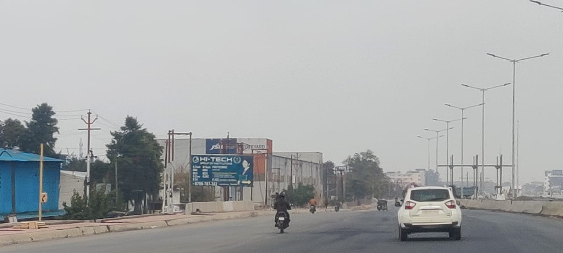
NH-24 Opp. IMS College
GHAZIABAD TO MURADABAD
Size : 20x10 Facing : Both side
Lit : Non Lit

Slide 3
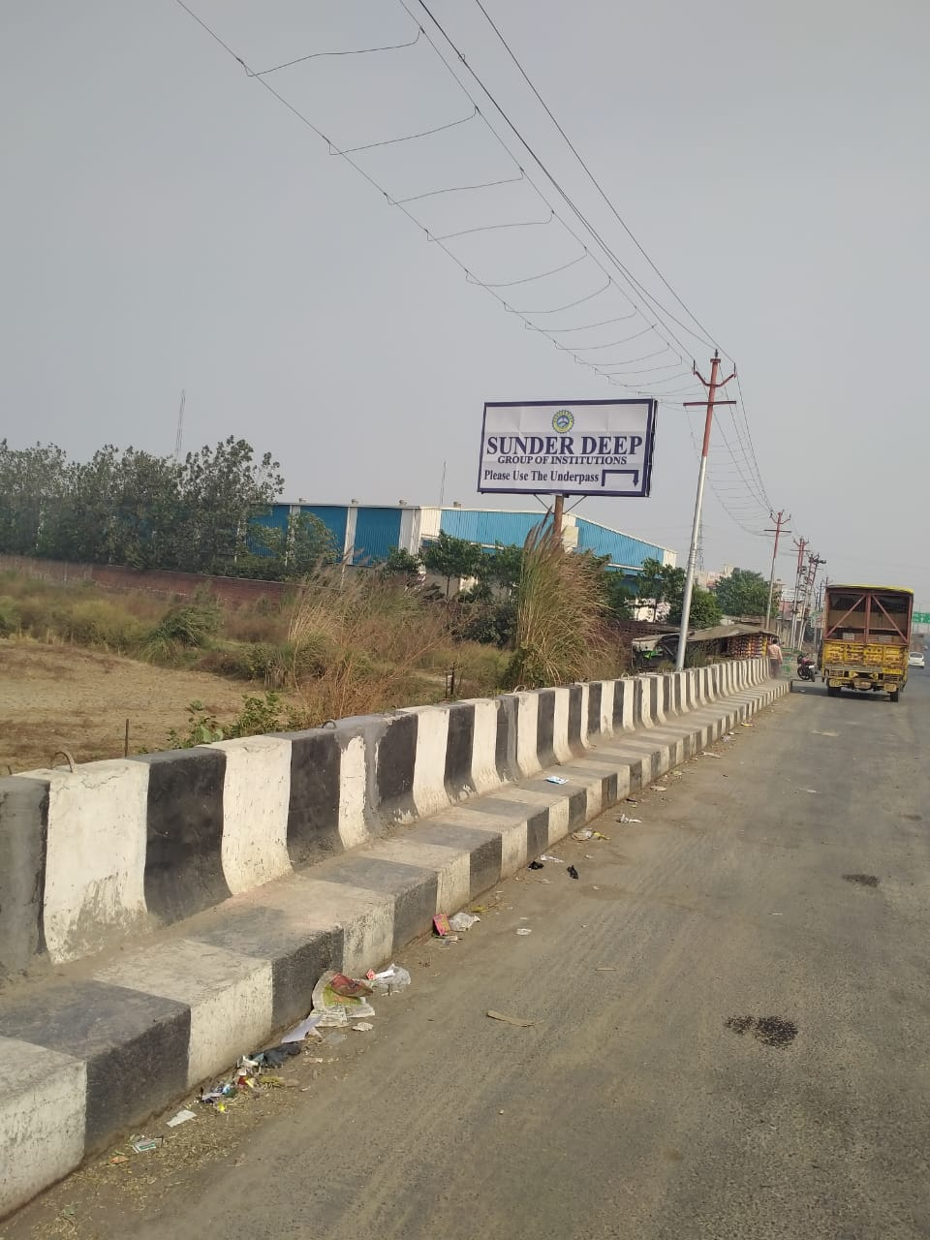
NH-24 OPP. SUNDER DEEP College
GHAZIABAD TO MURADABAD
Size : 20x10 Facing : Both side
Lit : Non Lit

Slide 4
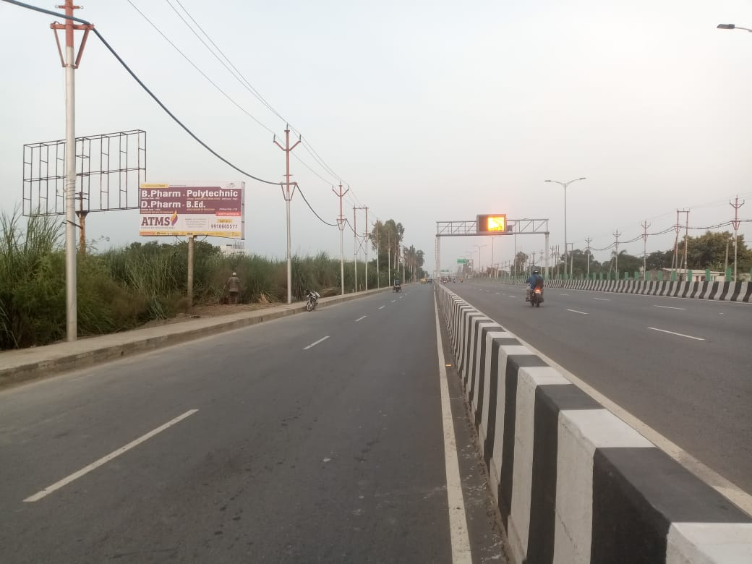
NH-24 OPP. RAMA HOSPITEL
GHAZIABAD TO MURADABAD
Size : 20x10 Facing : Both side
Lit : Non Lit

Slide 5
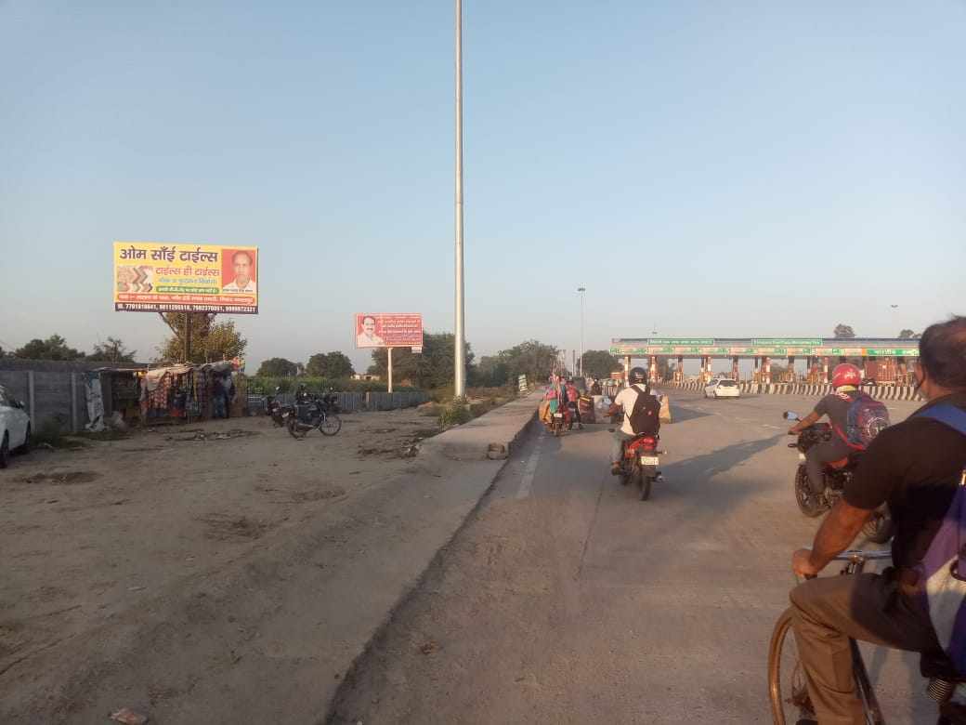
NH-24 Pilkhuwa Toll Plaza
GHAZIABAD TO MURADABAD
Size : 20x10 Facing : Both side
Lit : Non Lit

Slide 6
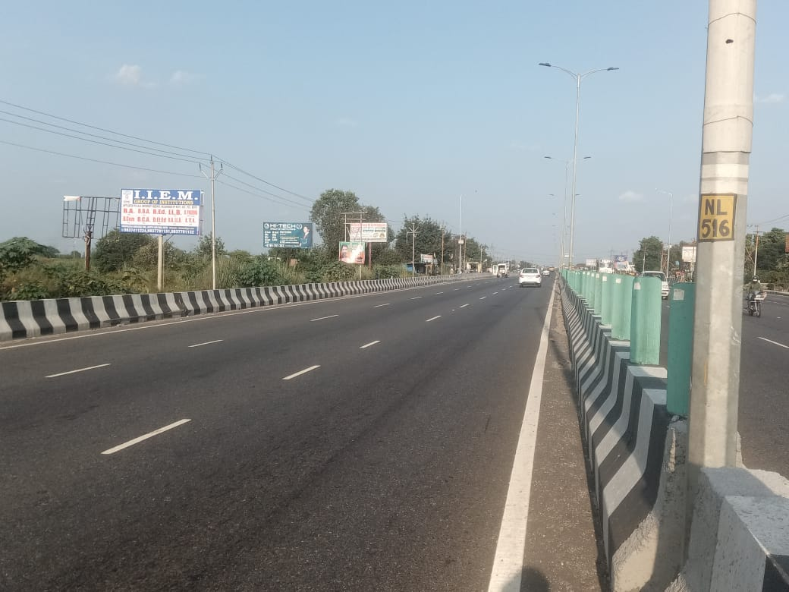
NH-24 Opp. Saraswali college
GHAZIABAD TO MURADABAD
Size : 20x10 Facing : Both side
Lit : Non Lit

Slide 7
NH-24 HAPUR ENTRY NIZAMPUR
HAPUR TO GHAZIABAD
Size : 30x10 Facing : Both side
Lit : Non Lit

Slide 8
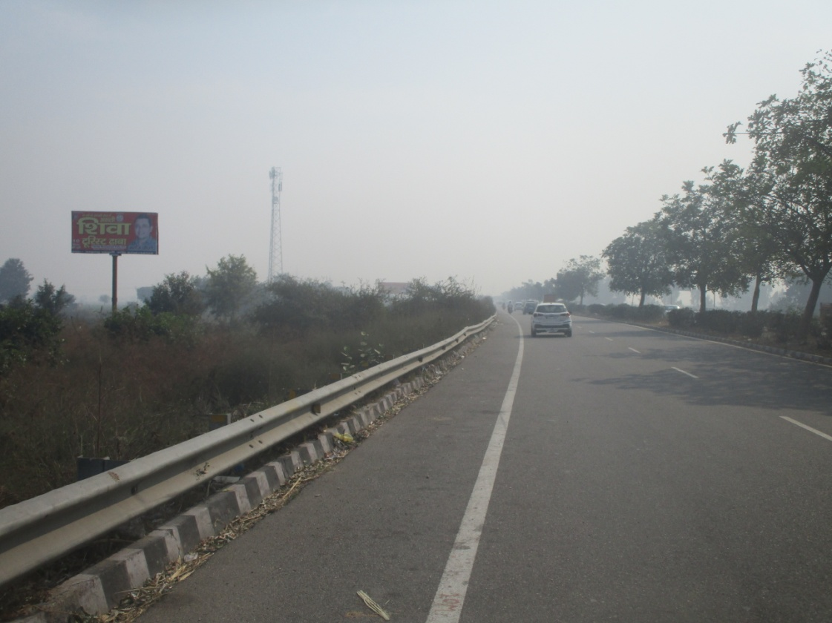
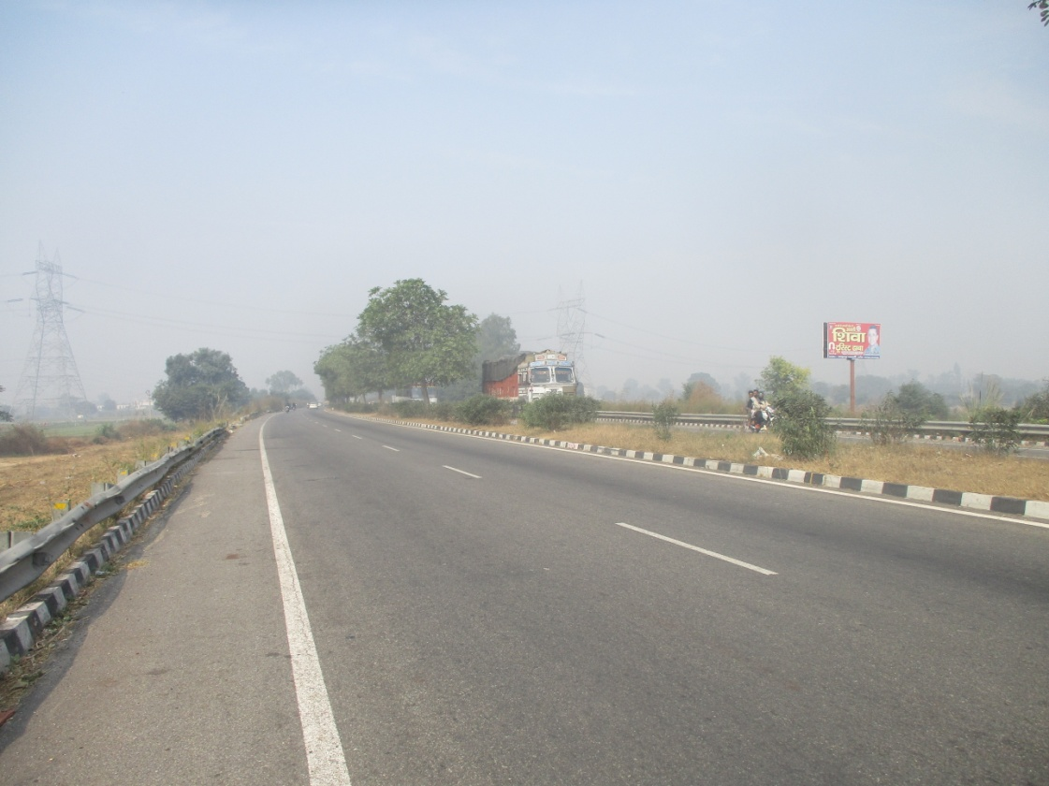
NH-24 HAPUR BYPASS ENTRY
HAPUR TO MURADABAD
Size : 20x10 Facing : Both side
Lit : Non Lit

Slide 9
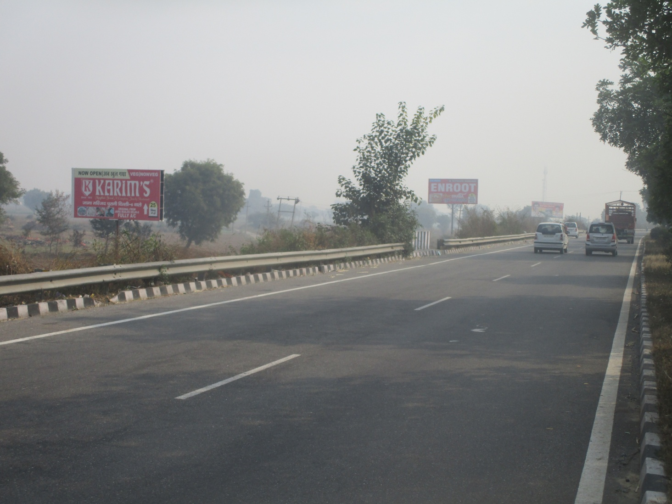
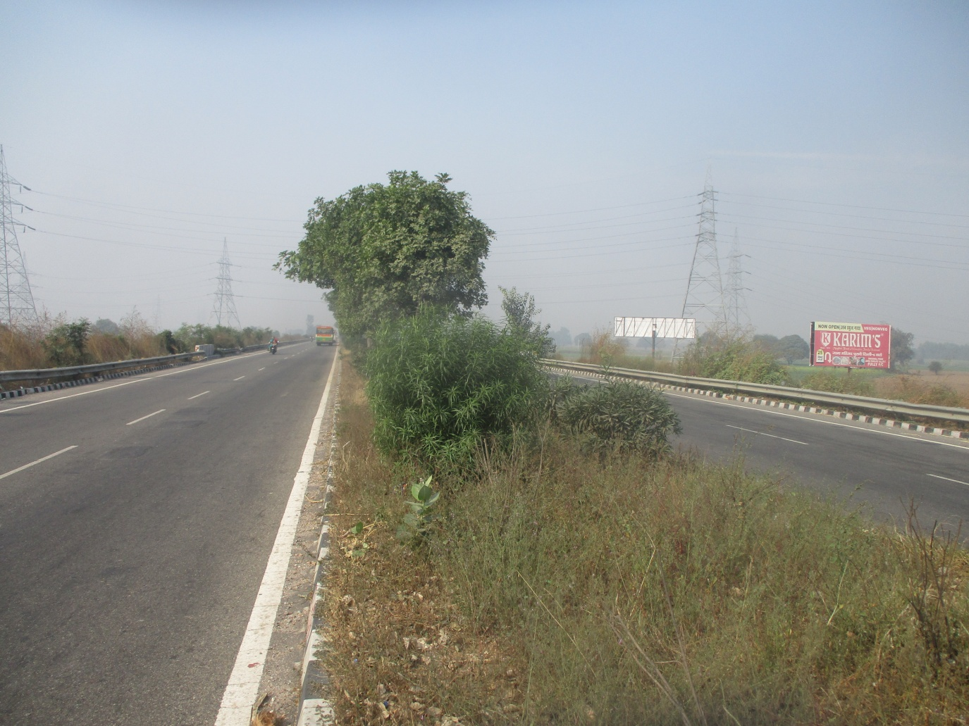
NH-24 HAPUR BYPASS
HAPUR TO MURADABAD
Size : 20x10 Facing : Both side
Lit : Non Lit

Slide 10
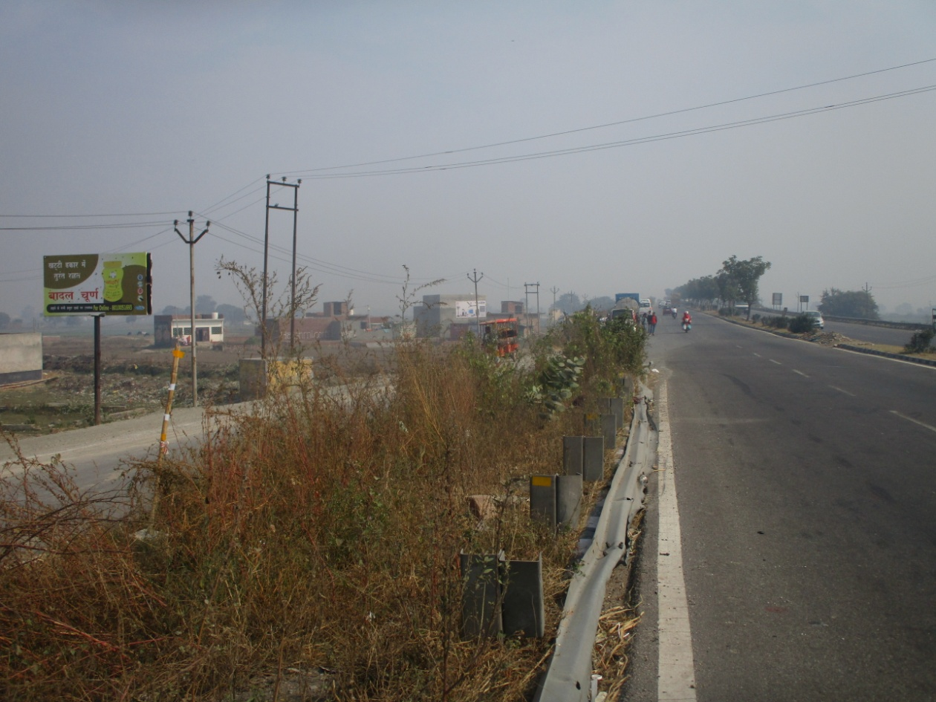
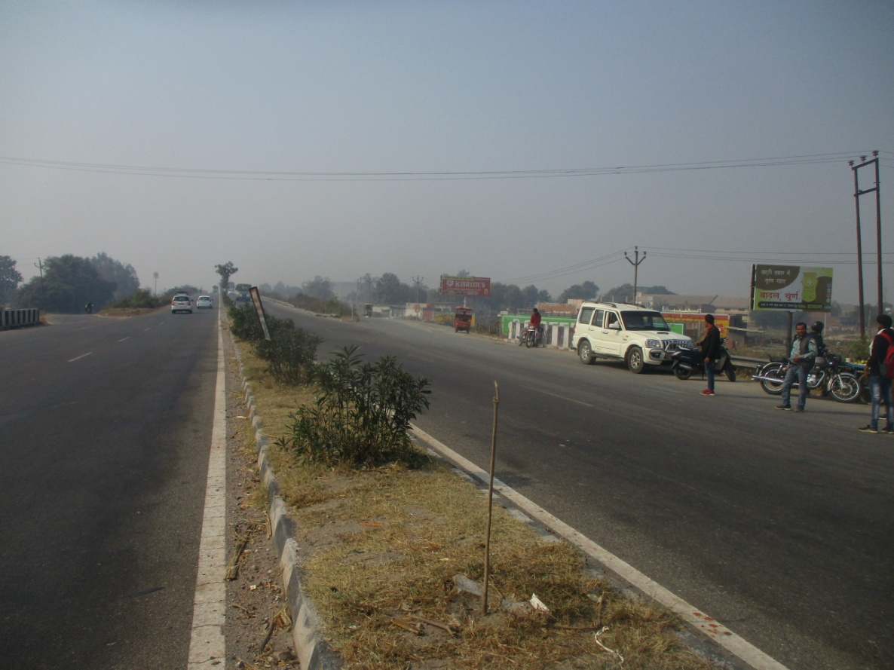
NH-24 BULANDSHAHAR ROAD HAPUR BYPASS
HAPUR TO MURADABAD
Size : 20x10 Facing : Both side
Lit : Non Lit

Slide 11
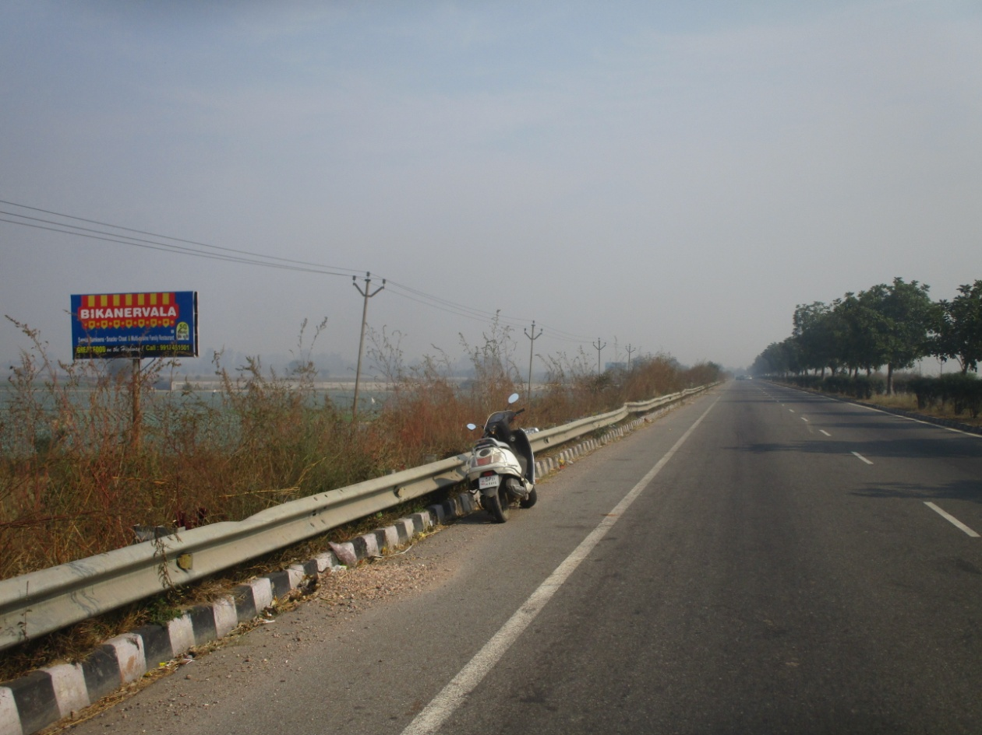
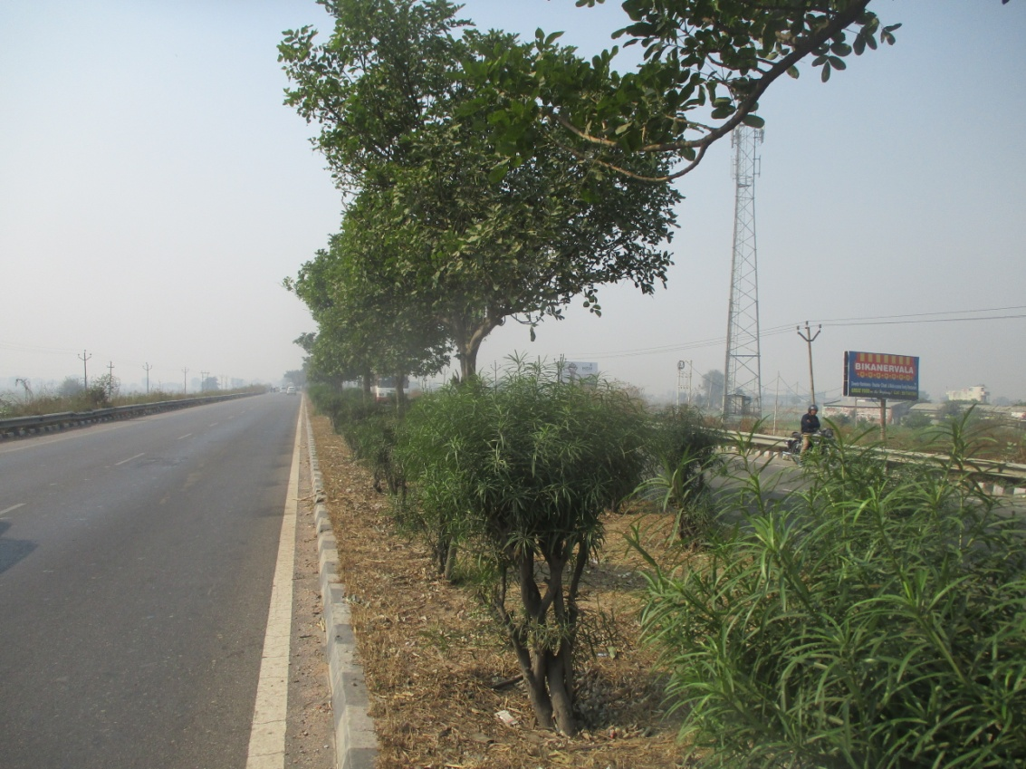
NH-24 HAPUR BYPASS NEAR HAPUR DEHAT THANA
HAPUR TO MURADABAD
Size : 20x10 Facing : Both side
Lit : Non Lit

Slide 12
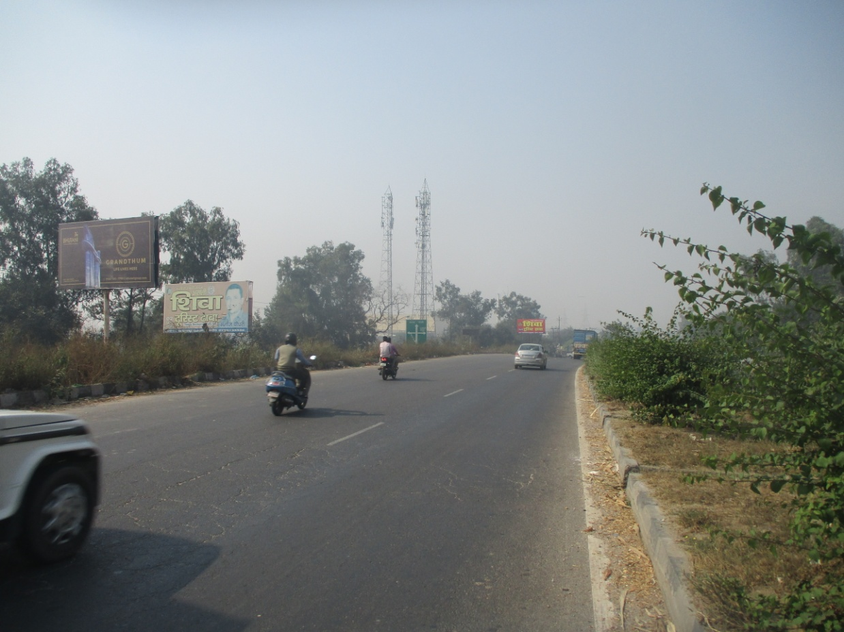
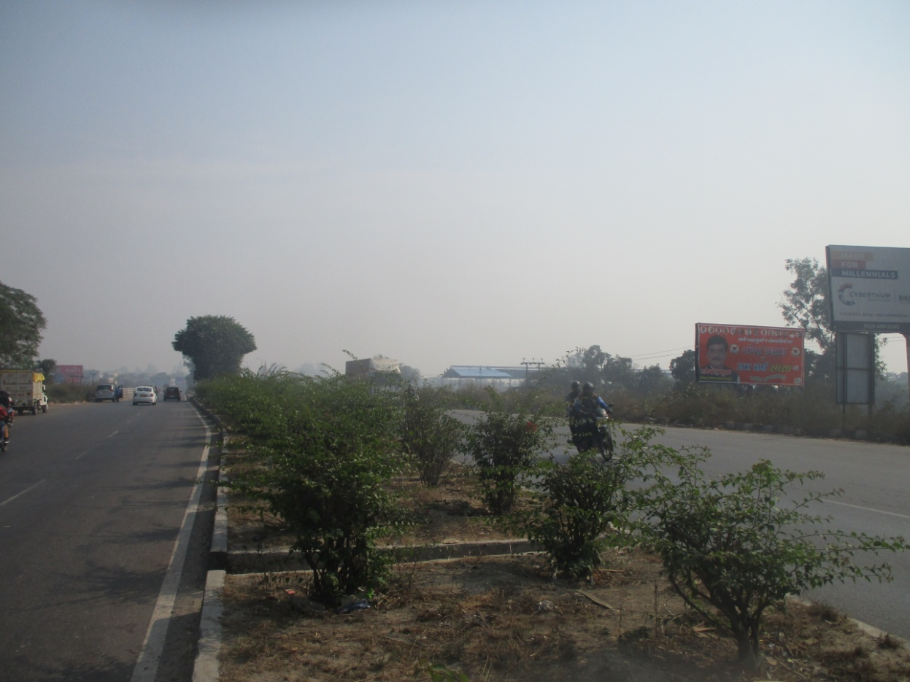
NH-24 TATARPUR TOLL TAX
MURADABAD TO HAPUR
Size : 20x10 Facing : Both side
Lit : Non Lit

Slide 13
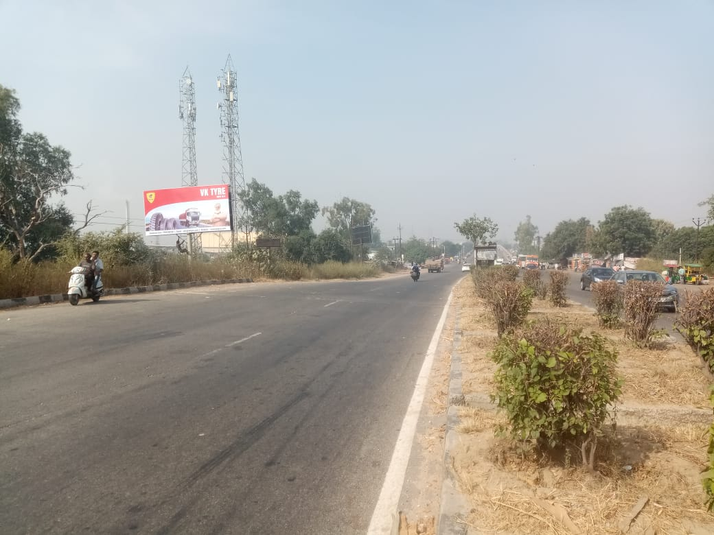
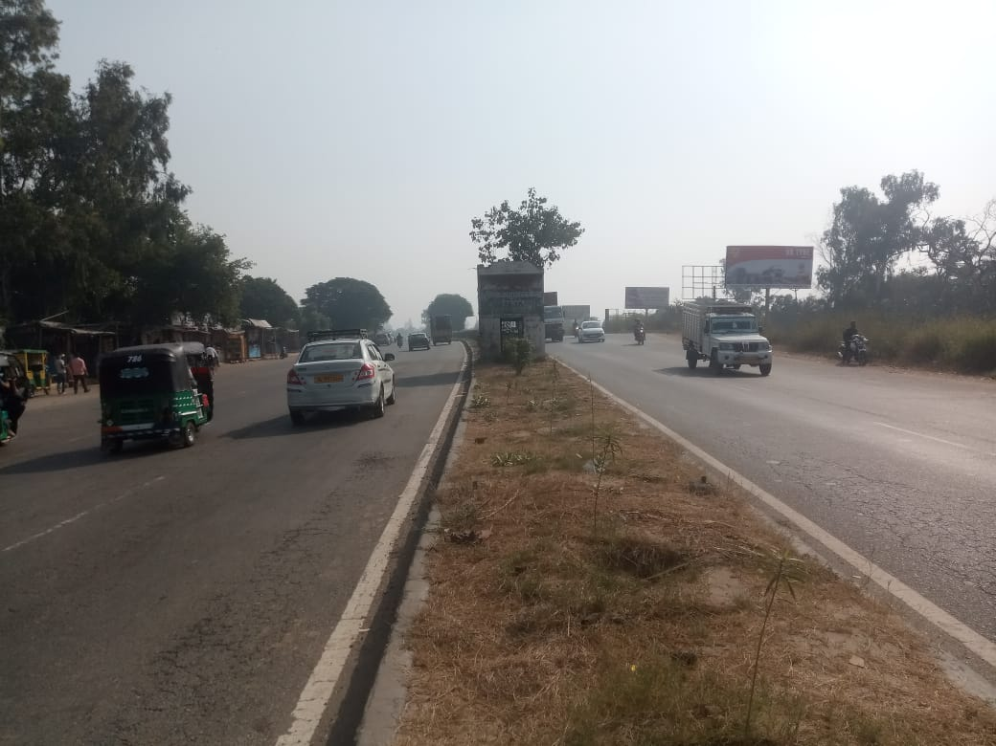
NH-24 TATARPUR TOLL TAX
Brighat TO HAPUR
Size : 20x10 Facing : Both side
Lit : Non Lit

Slide 14
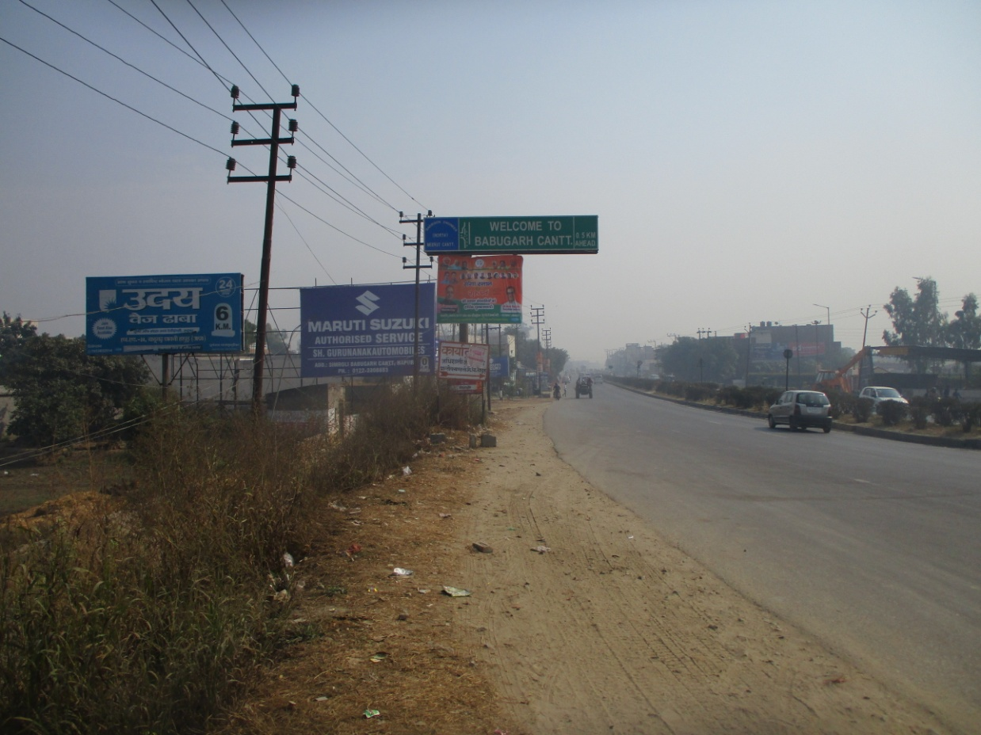
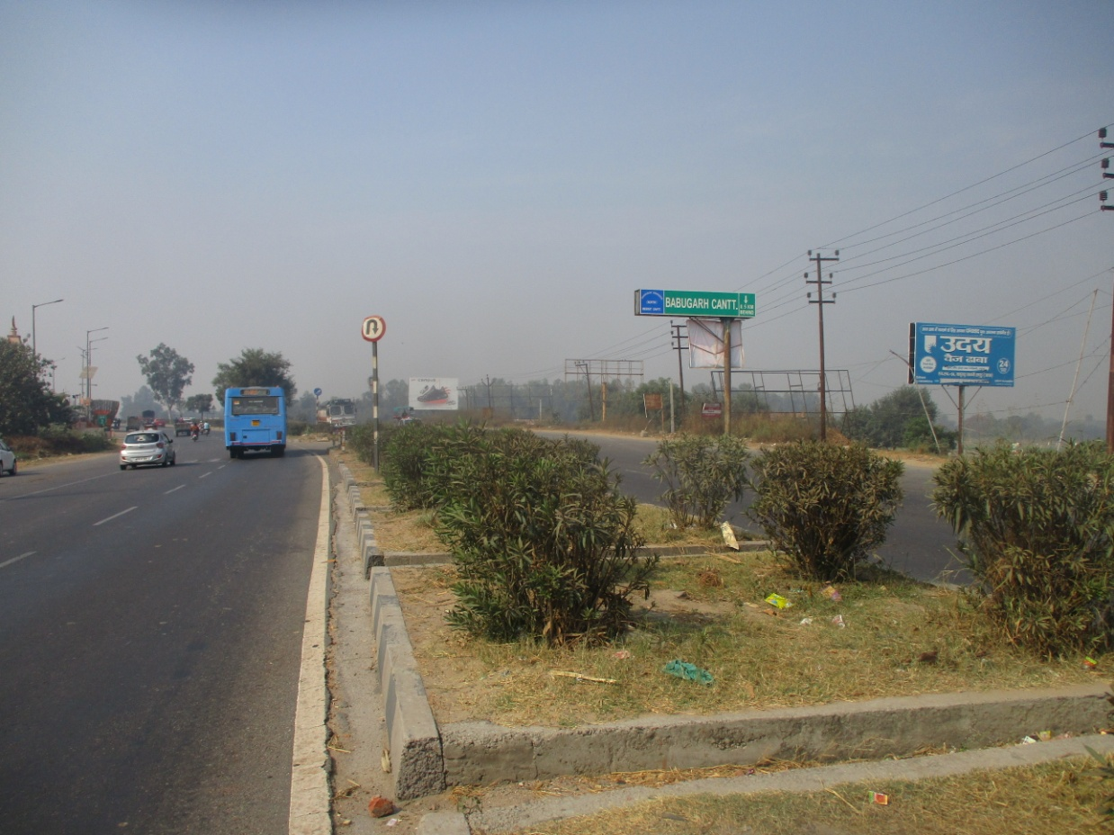
NH-24SIMROLI VILLAGAE
HAPUR TO MURADABAD
Size : 20x10 Facing : Both side
Lit : Non Lit

Slide 15
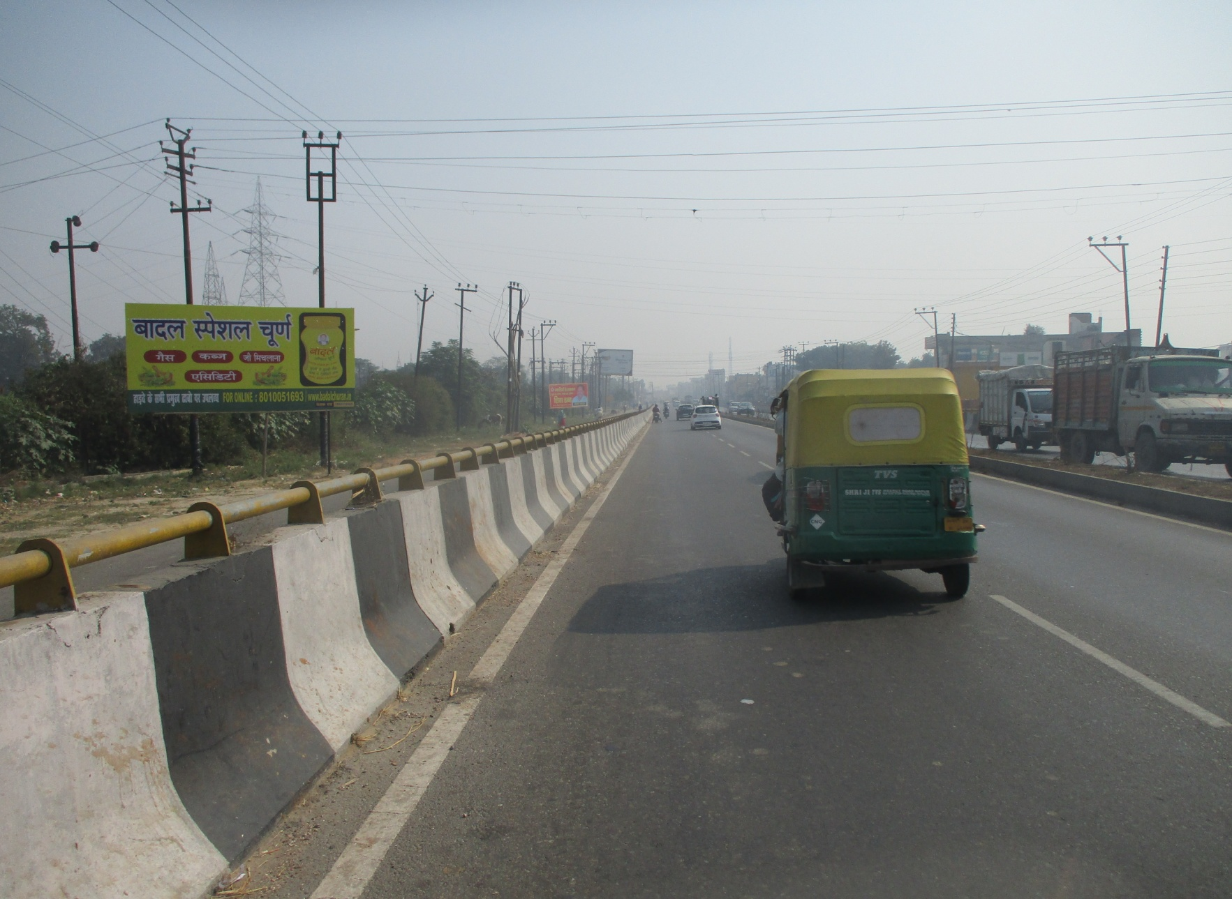
NH-24 CHAWANI BIJALI GHAR
HAPUR TO MURADABAD
Size : 20x10 HOARDING SIDE
Lit : Non Lit

Slide 16
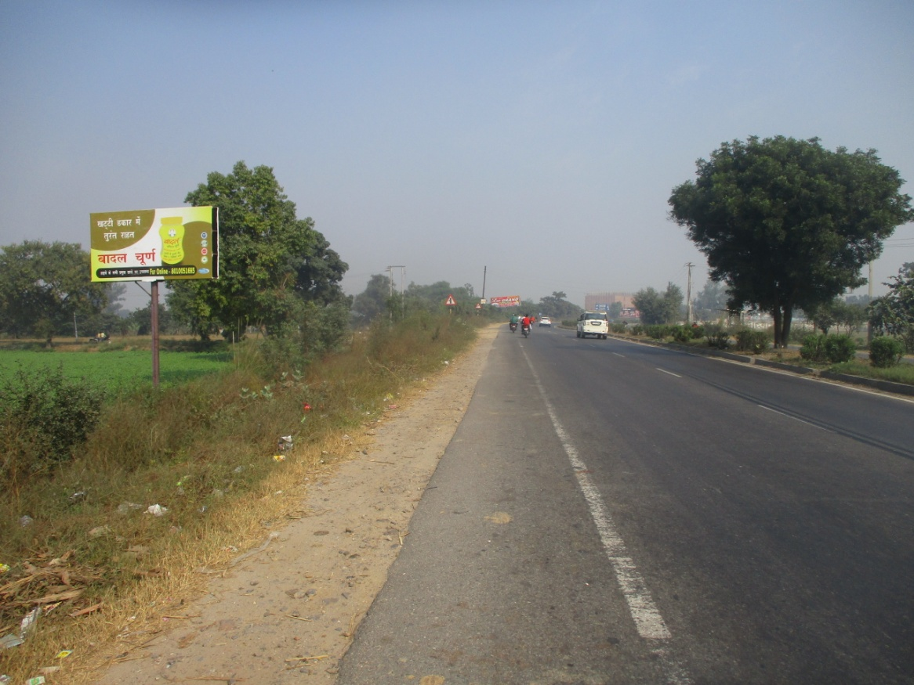
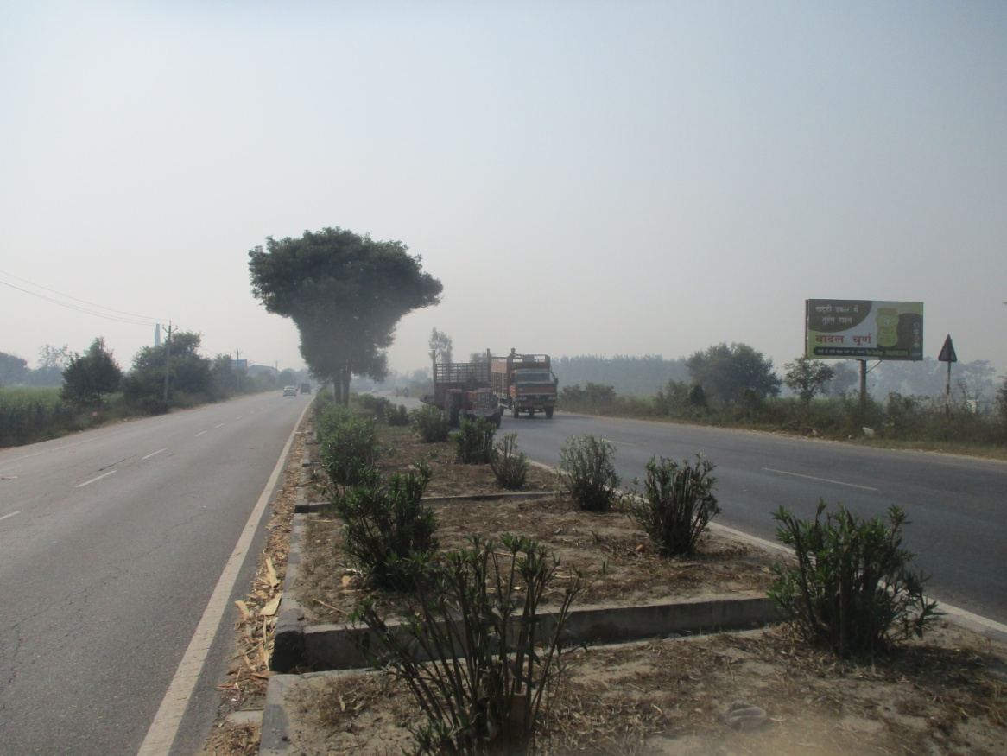
NH-24 ATUTA OPP. UDAY DHABA
HAPUR TO MURADABAD
Size : 20x10 Facing : Both side
Lit : Non Lit

Slide 17
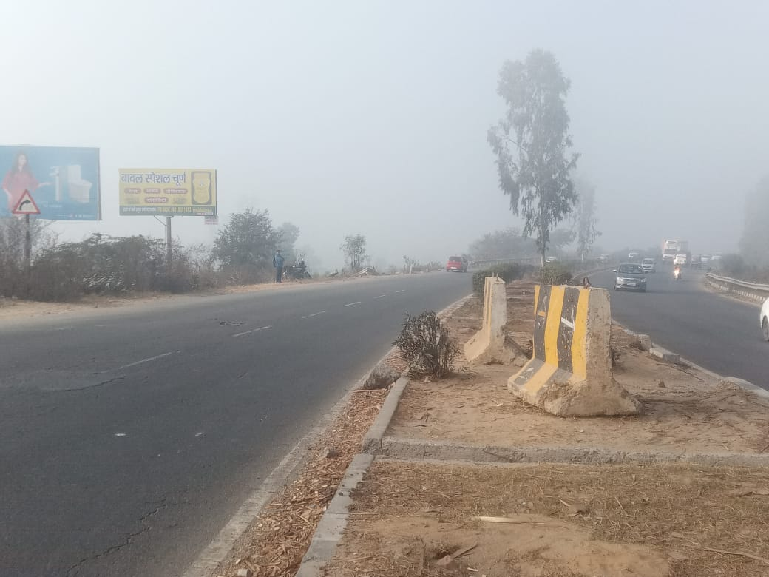
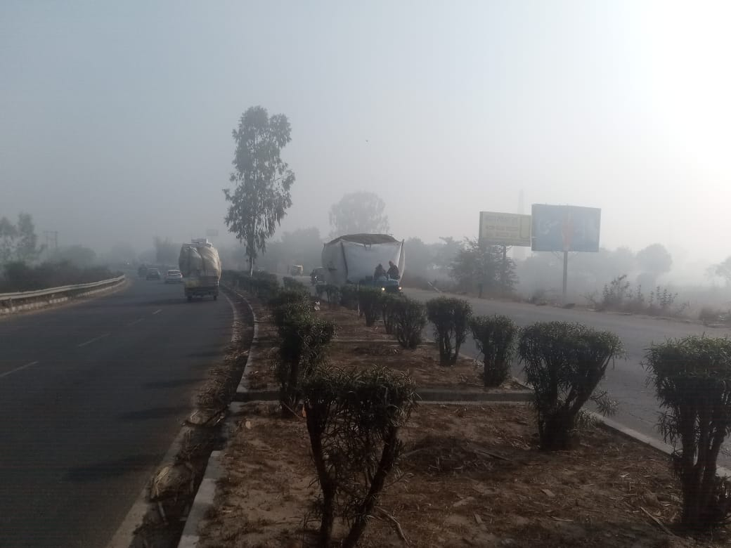
NH-24 Near UDAY DHABA Attuta
Brighat To HAPUR
Size : 20x10 Facing : Both side
Lit : Non Lit

Slide 18
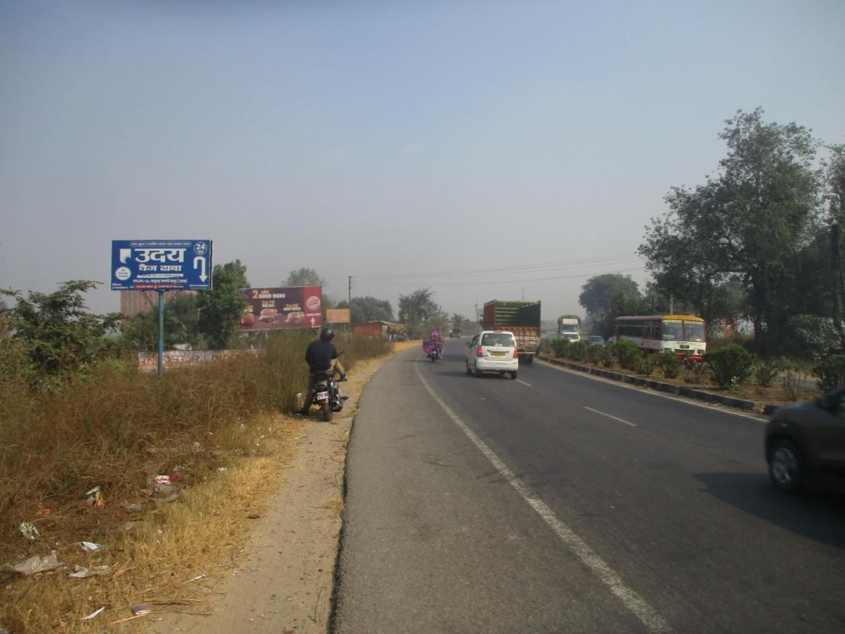
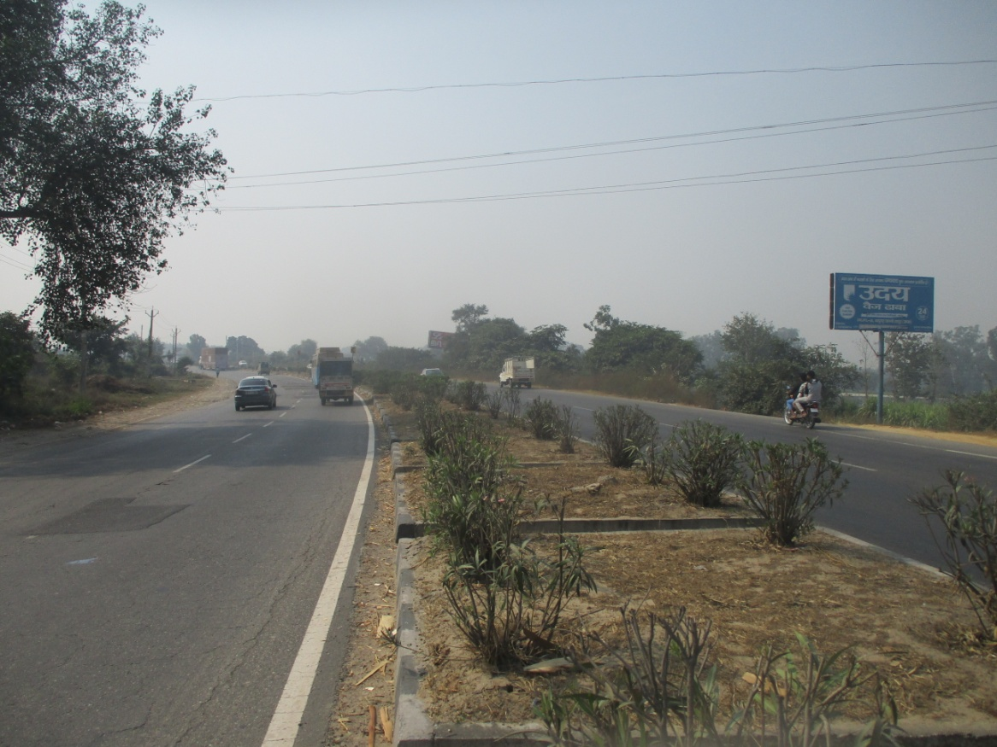
NH-24 ATUTA NEAR DHABA
HAPUR TO MURADABAD
Size : 20x10 Facing : Both side
Lit : Non Lit

Slide 19
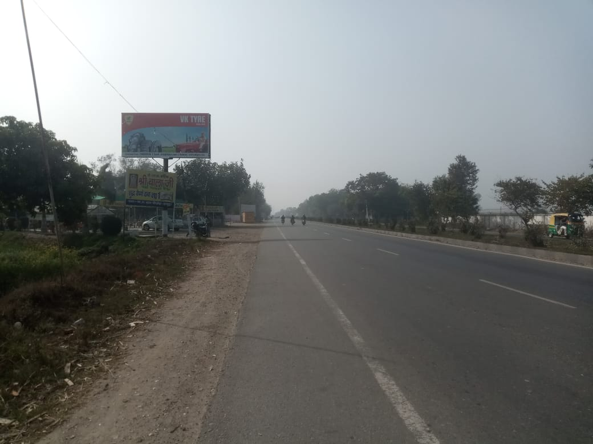
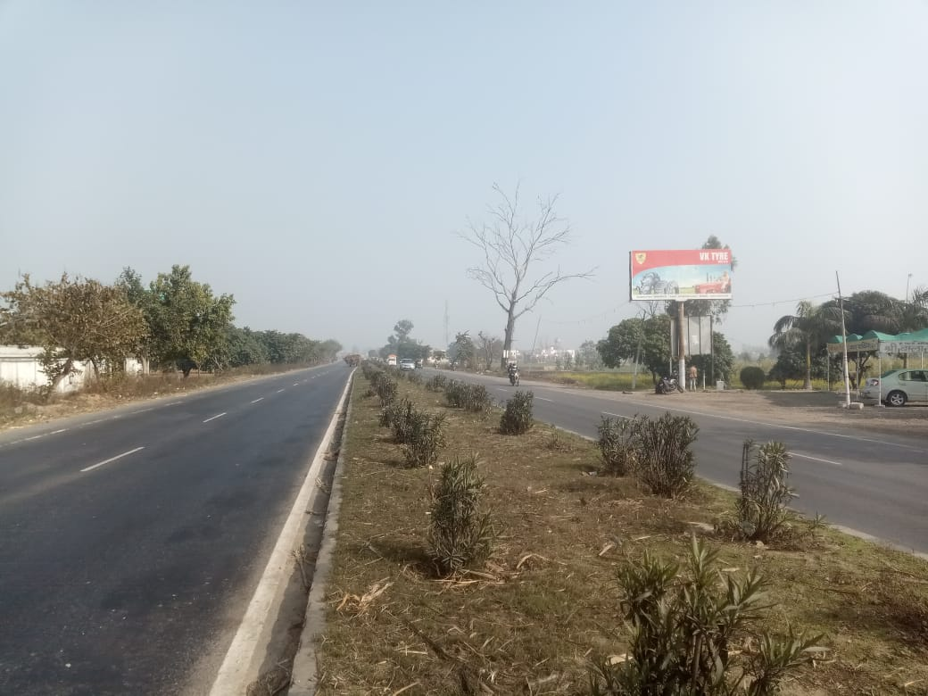
NH-24 Sikhera Balaji Hotel
Gajraula to Hapur
Size : 20x10 Facing : Both side
Lit : Non Lit

Slide 20
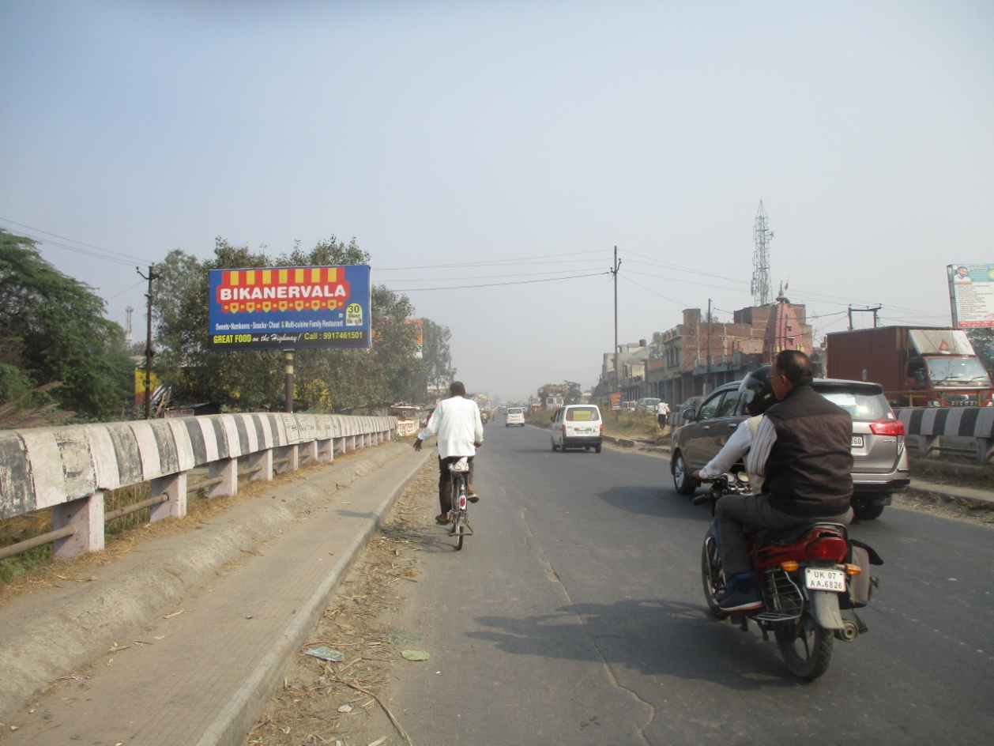
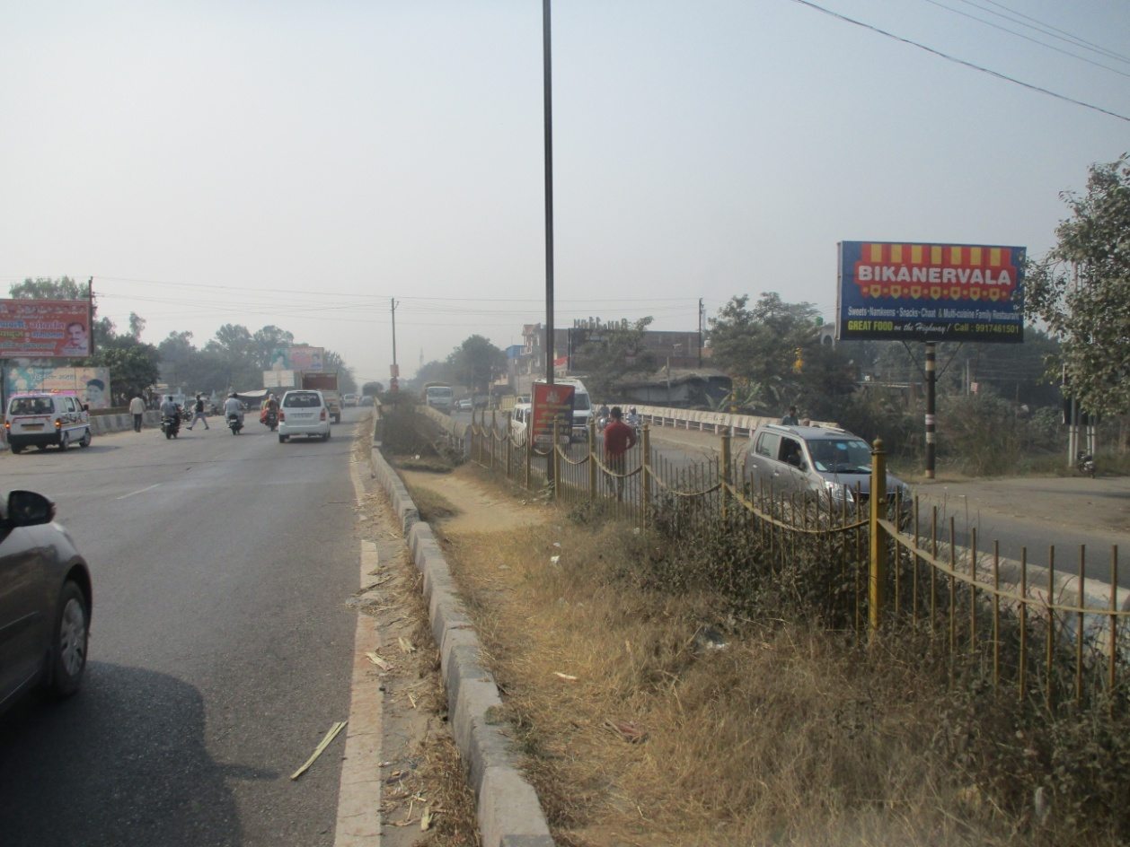
NH-24 SIMBHAOLI NAHAR
HAPUR TO MURADABAD
Size : 20x10 Facing : Both side
Lit : Non Lit

Slide 21
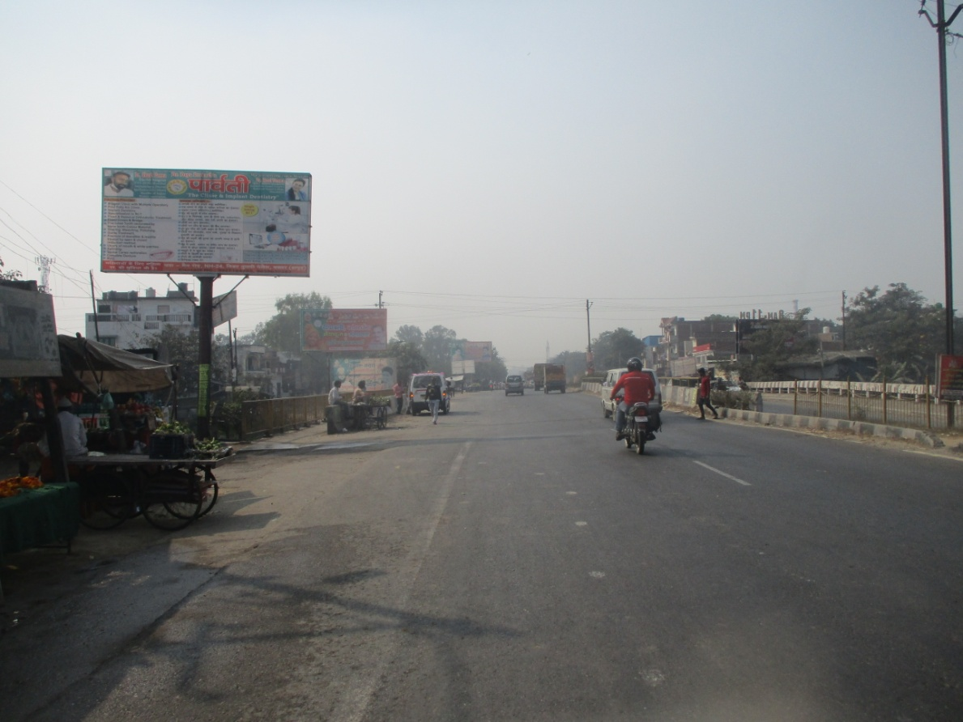
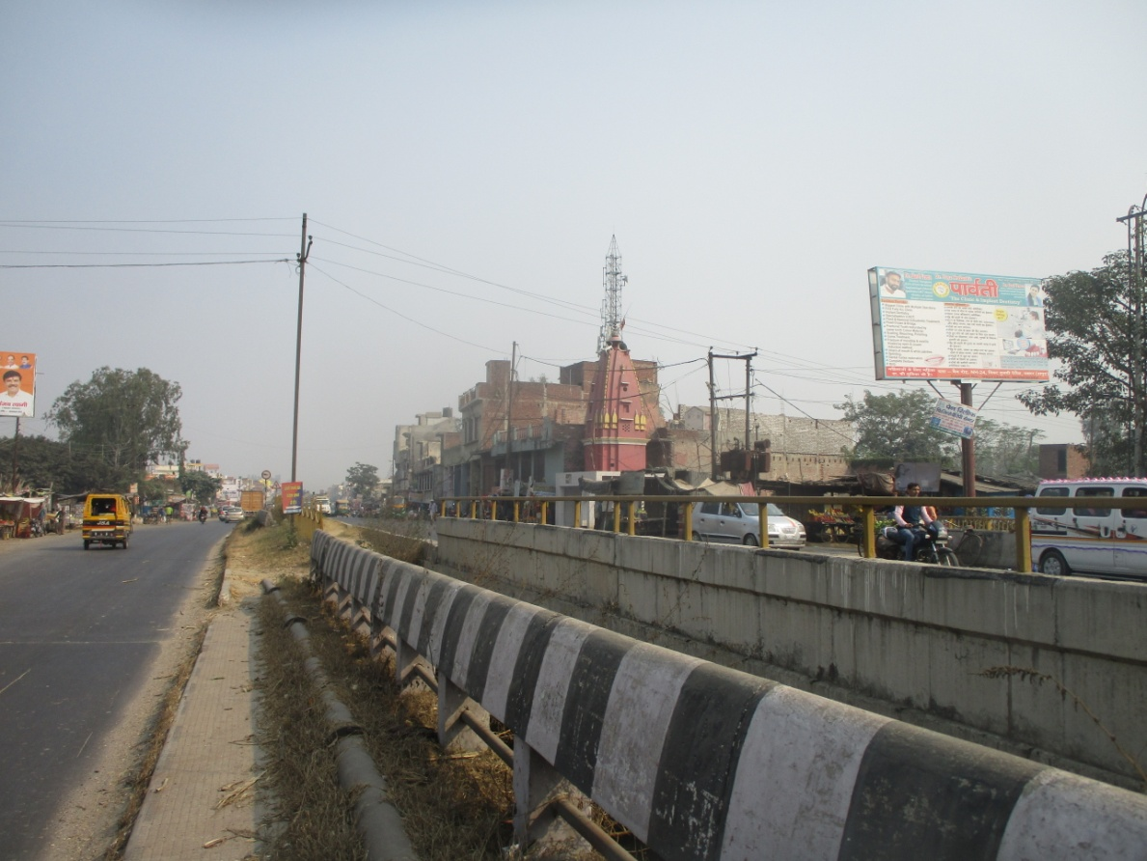
NH-24 SIMBHAOLI NAHAR
MURADABAD TO HAPUR
Size : 20x10 Facing : Both side
Lit : Non Lit

Slide 22
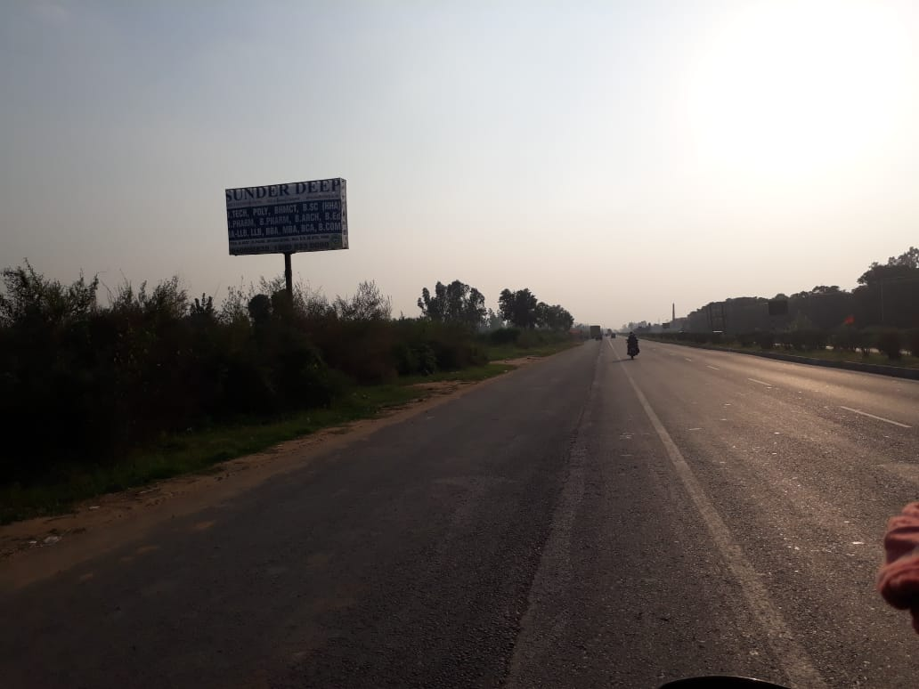
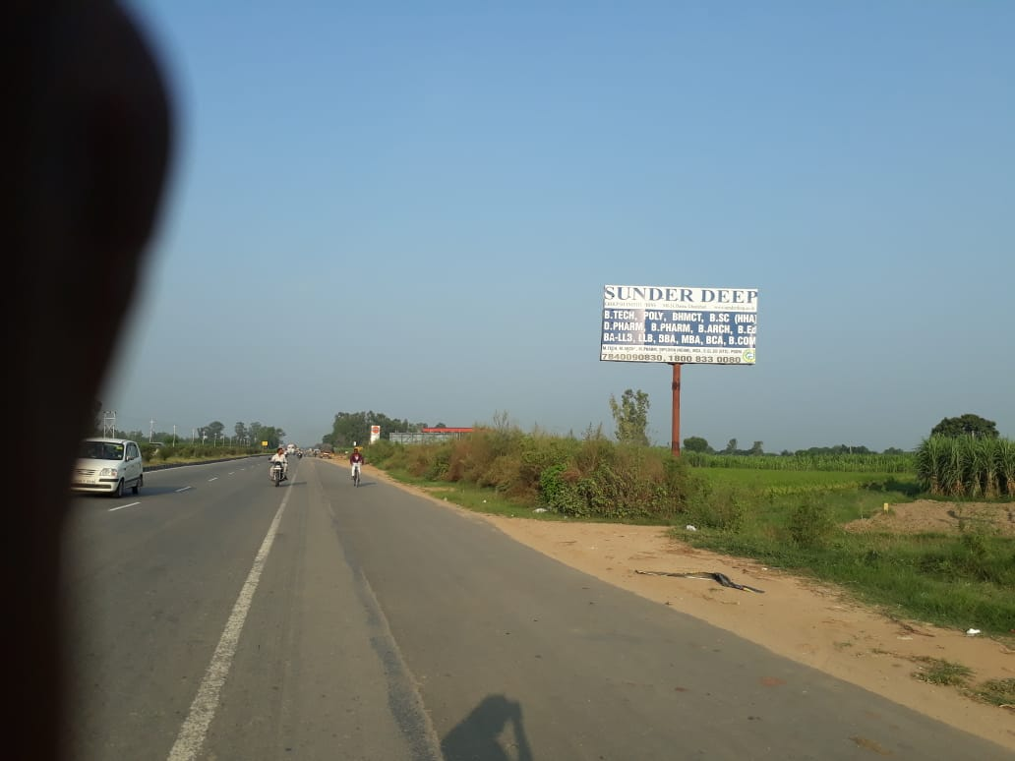
NH-24 SR. Patrol Pump Sarurpur
MURADABAD TO HAPUR
Size : 20x10 Facing : Both side
Lit : Non Lit

Slide 23
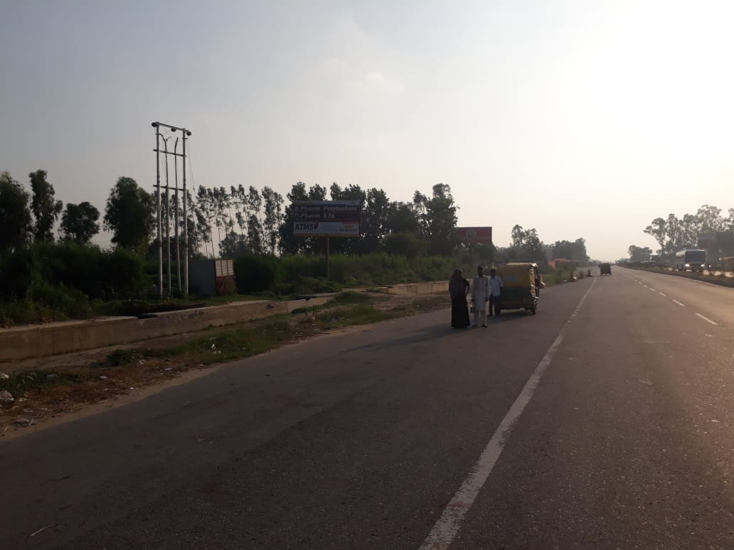
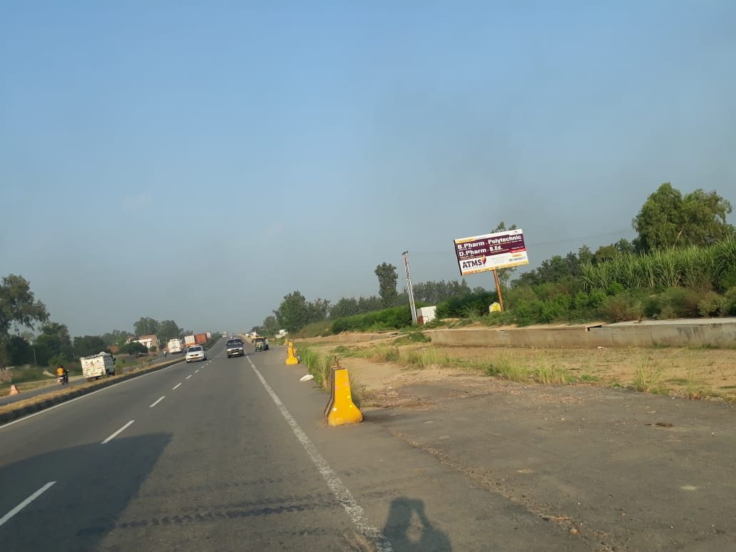
NH-24 Attshani Bridge
MURADABAD TO HAPUR
Size : 20x10 Facing : Both side
Lit : Non Lit

Slide 24
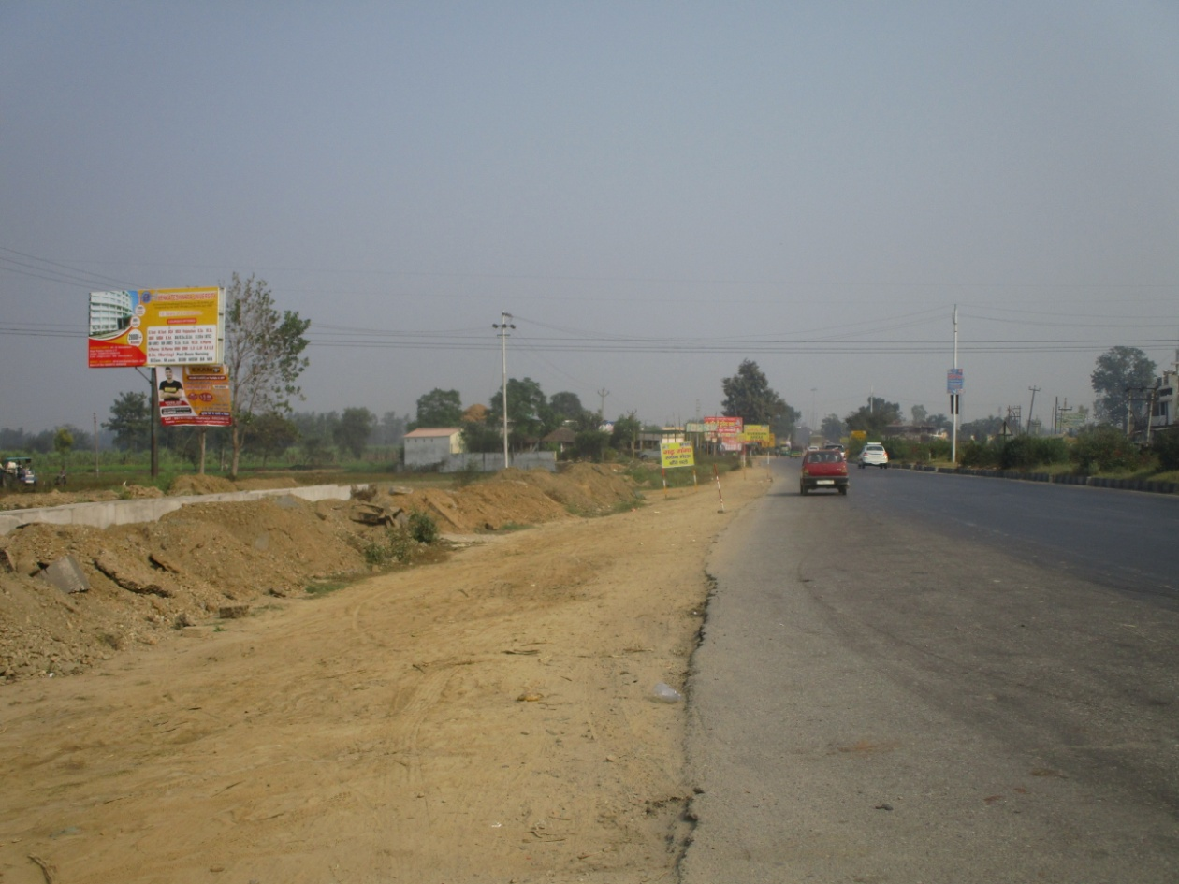
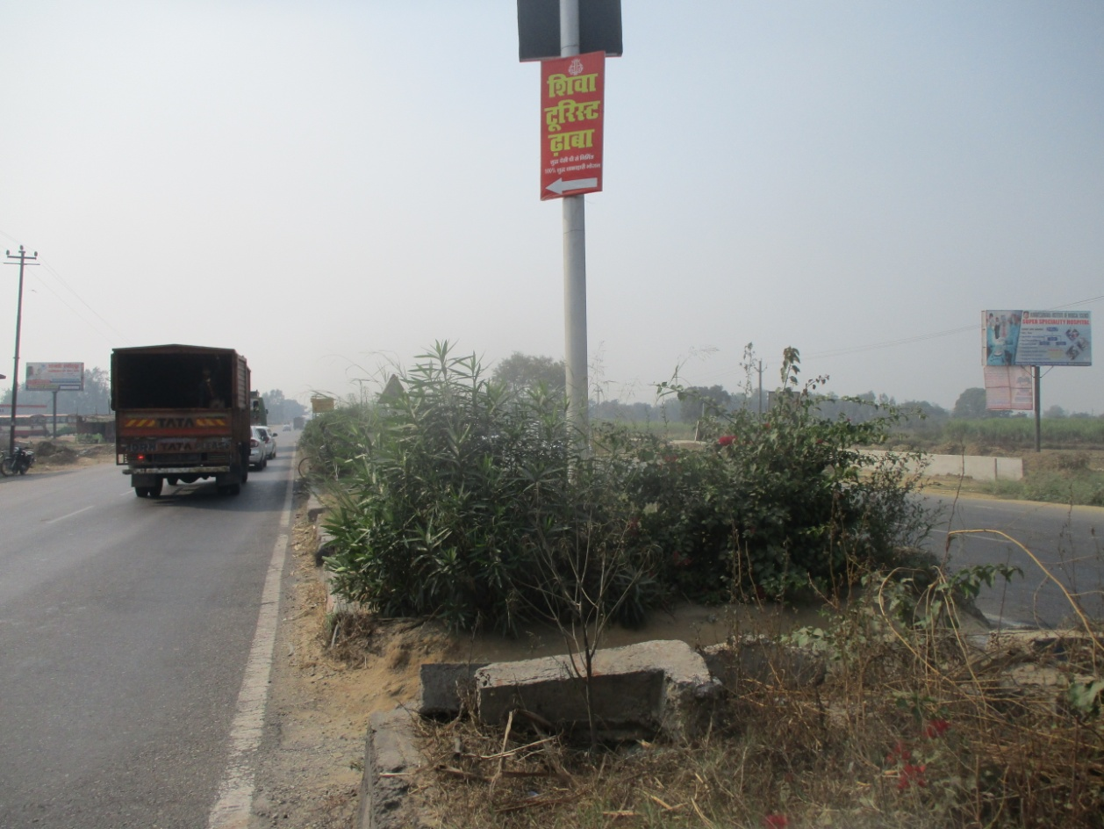
NH-24 GARH ENTRY TRY ANGEL
HAPUR TO MURADABAD
Size : 20x10 Facing : Both side
Lit : Non Lit

Slide 25
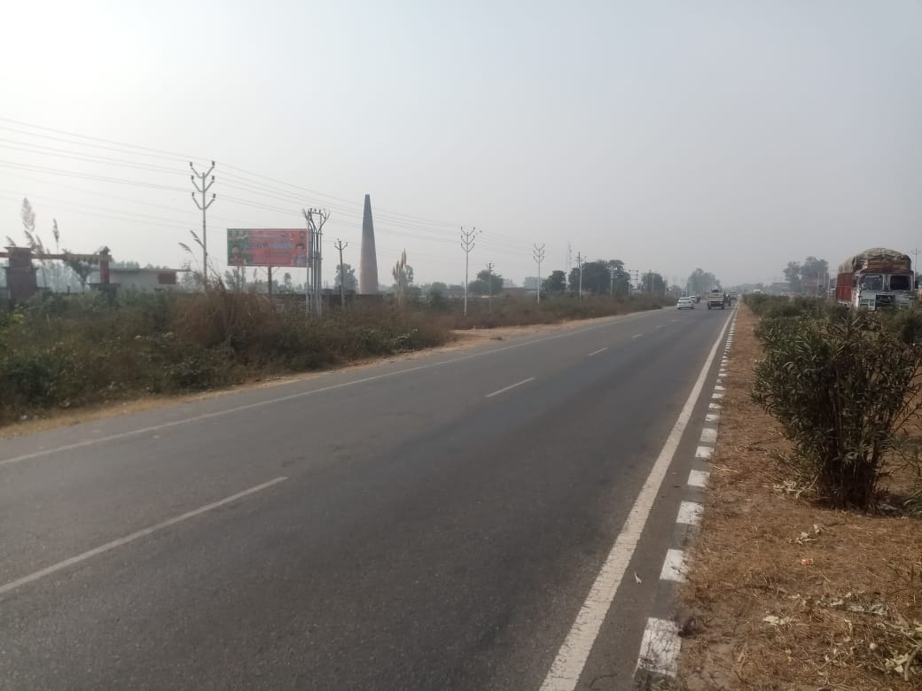
NH-24 Opp Leegrand Hotel
Muradabad TO HAPUR
Size : 25x10 Facing : Both side
Lit : Non Lit

Slide 26
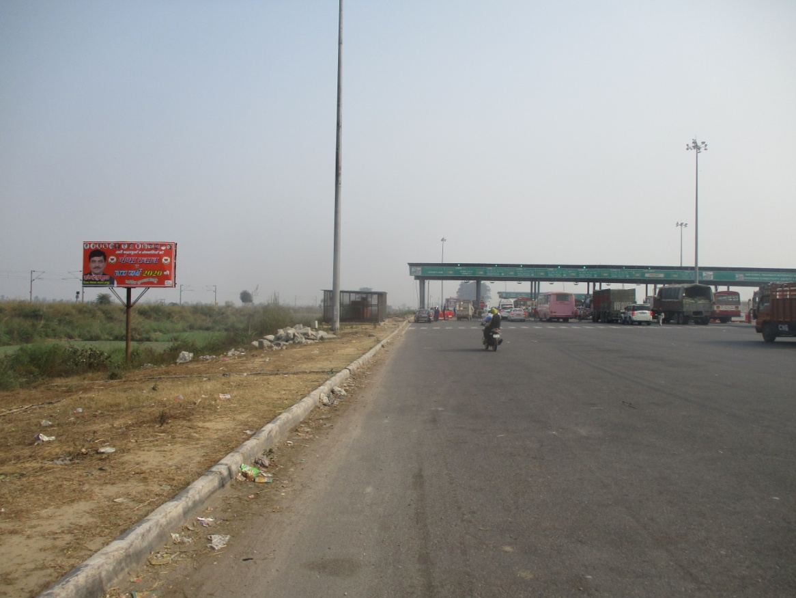
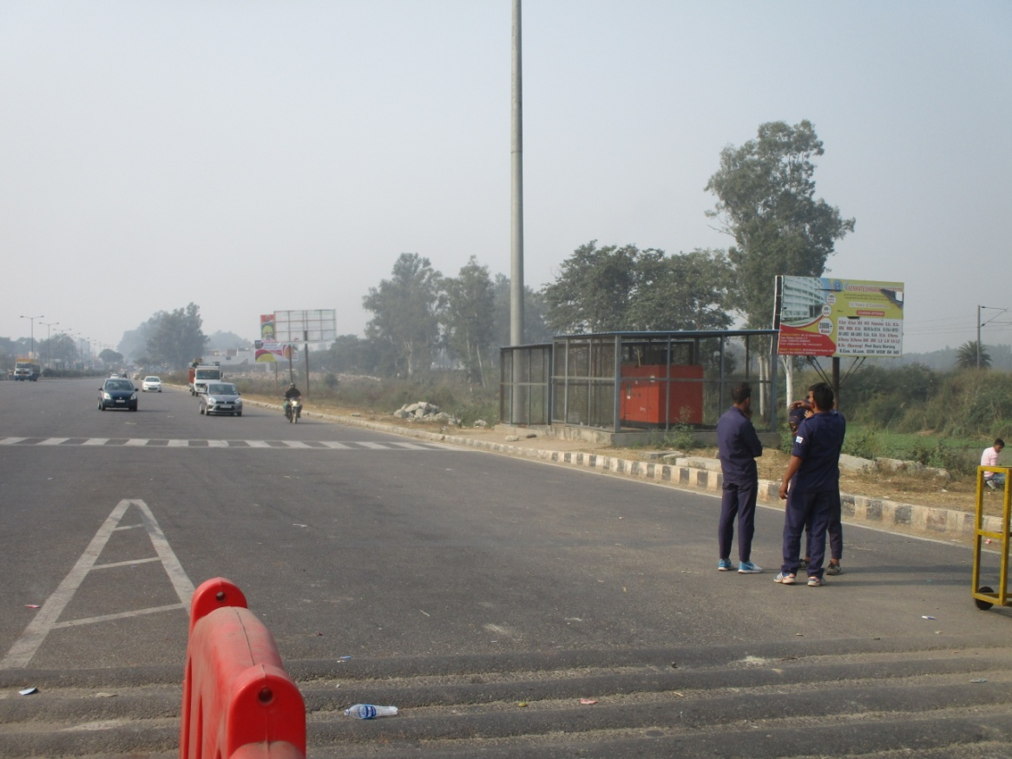
NH-24 BRIJGHAT TOLL PLAZA
HAPUR TO MURADABAD
Size : 20x10 Facing : Both side
Lit : Non Lit

Slide 27
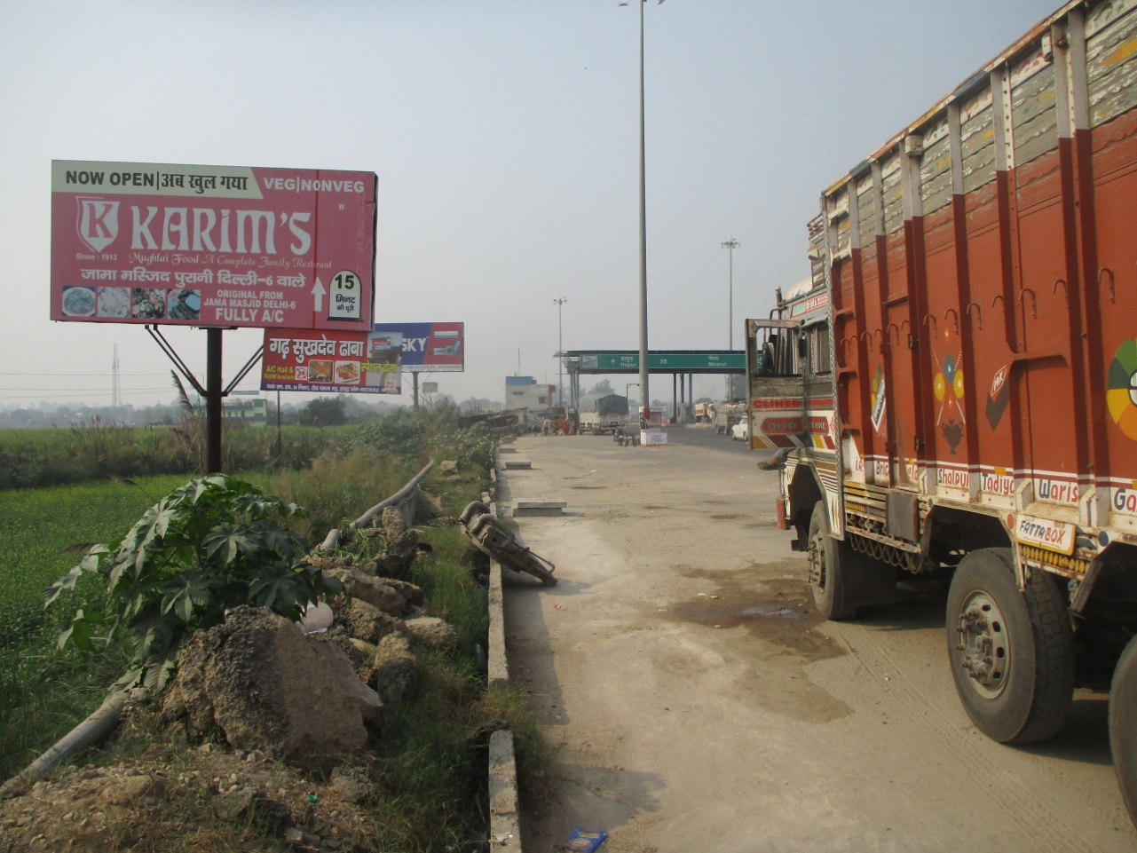
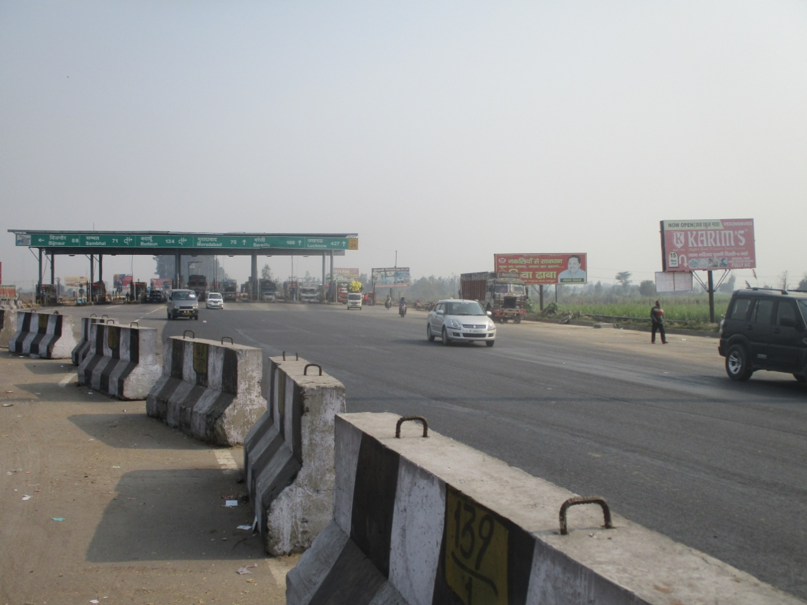
NH-24 BRIJGHAT TOLL PLAZA
MURADABAD TO HAPUR
Size : 20x10 Facing : Both side
Lit : Non Lit

Slide 28
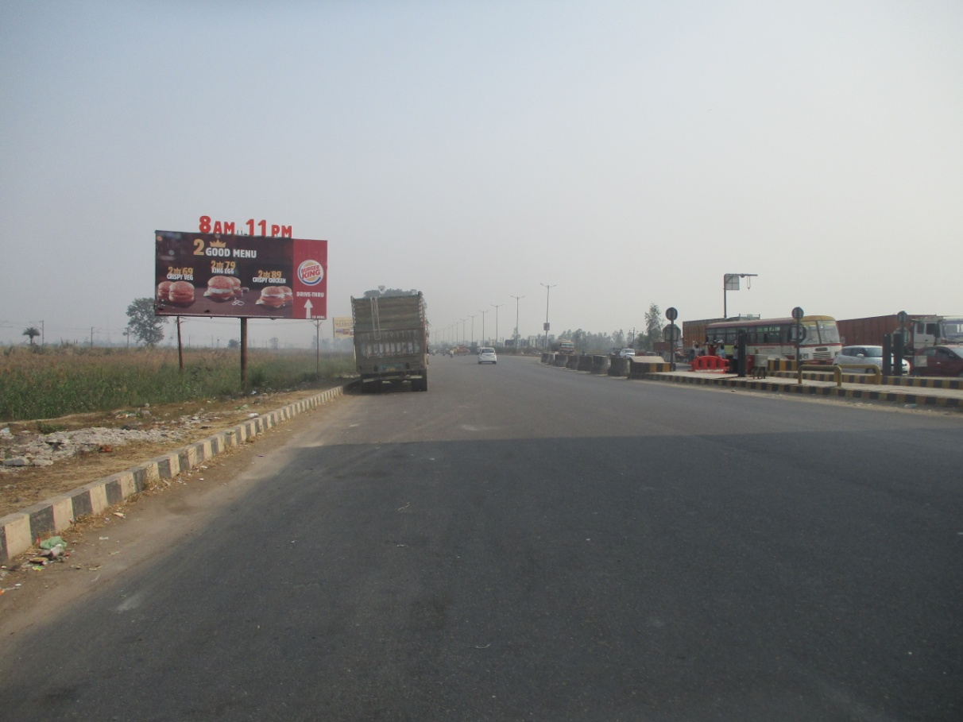
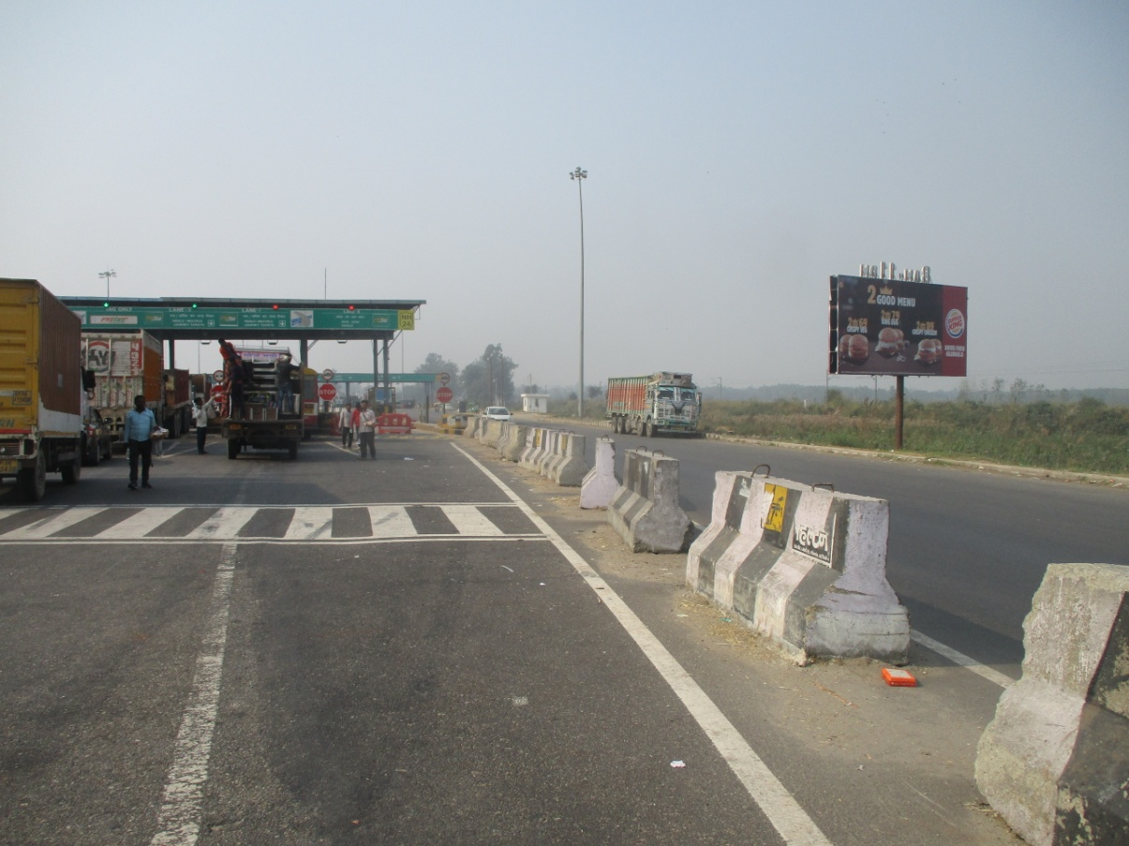
NH-24 GARH TOLL PLAZA
HAPUR TO MURADABAD
Size : 30X15 Facing : Both side
Lit : Non Lit

Slide 29
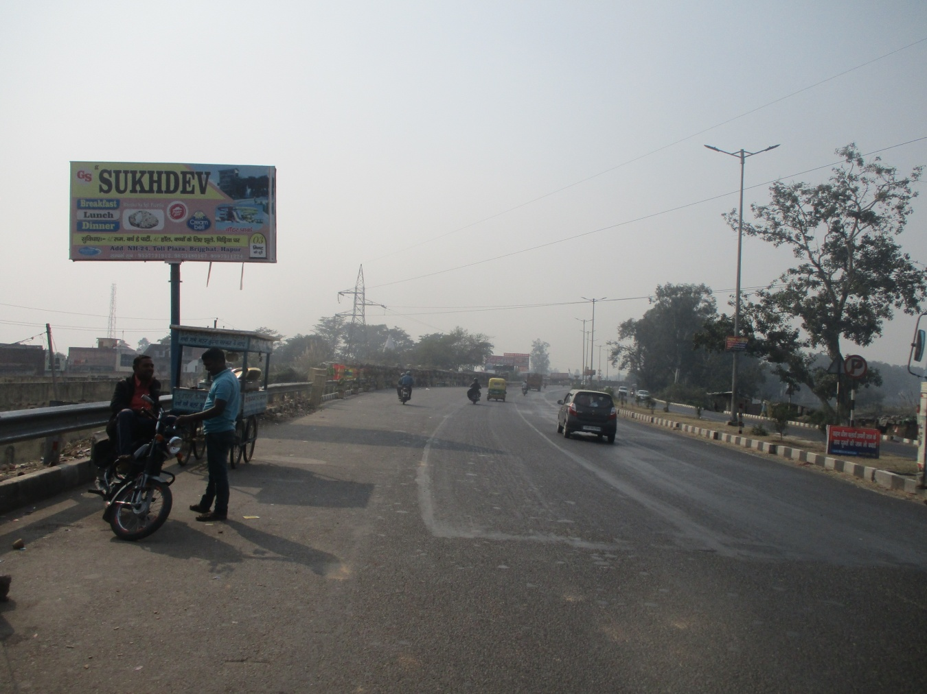
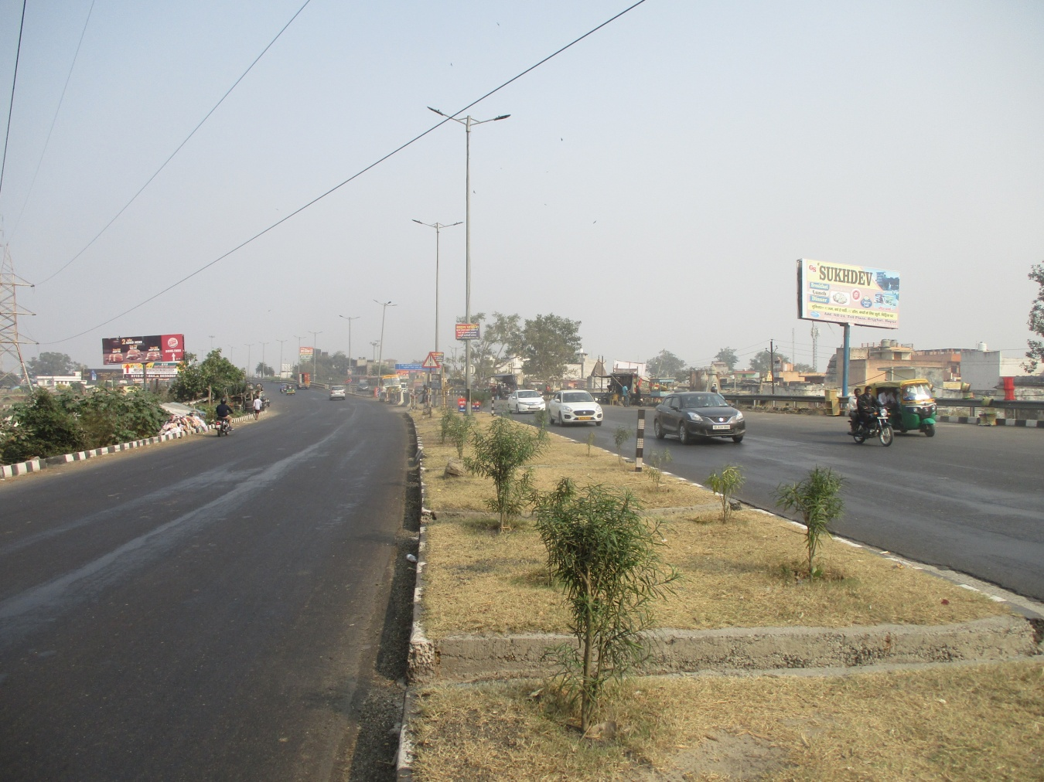
NH-24 CHORAHA BRIJGHAT
MURADABAD TO HAPUR
Size : 20x10 Facing : Both side
Lit : Non Lit

Slide 30
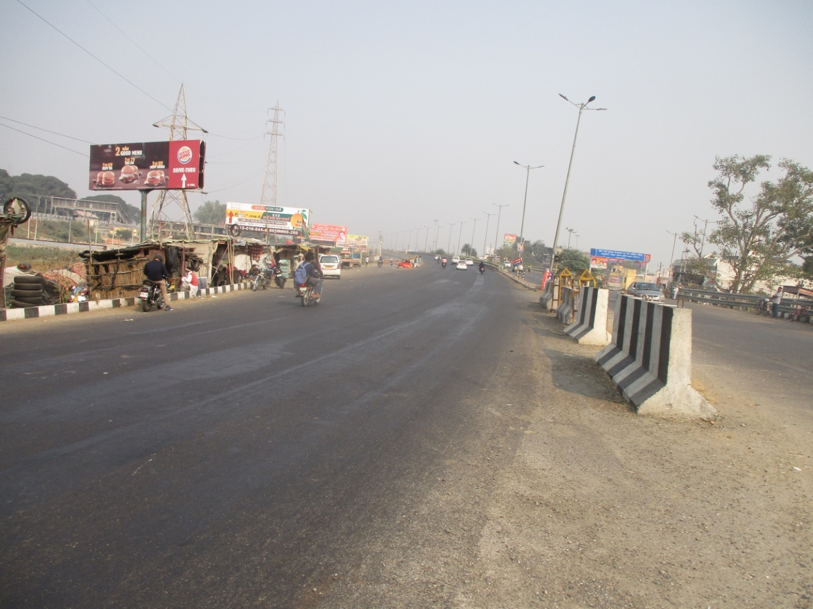
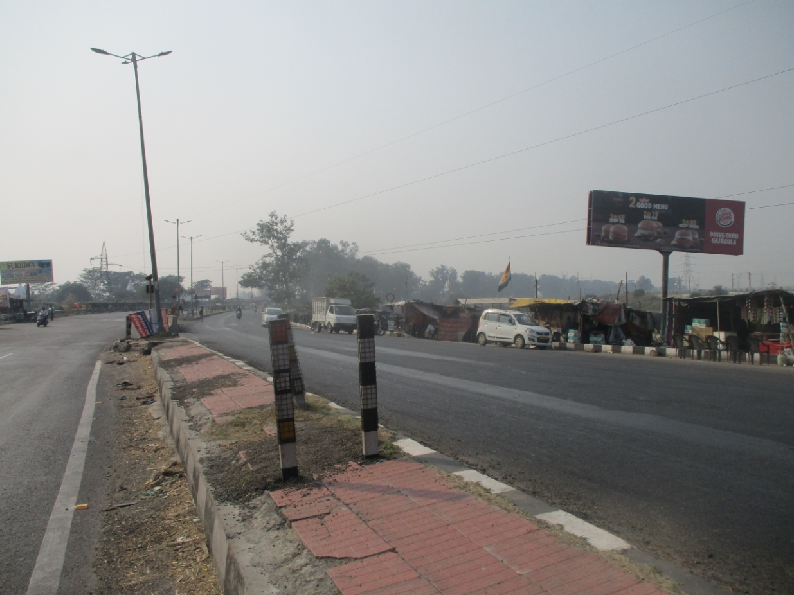
NH-24 BRIJGHAT CHORAHA
HAPUR TO MURADABAD
Size : 30x10 Facing : Both side
Lit : Non Lit

Slide 31
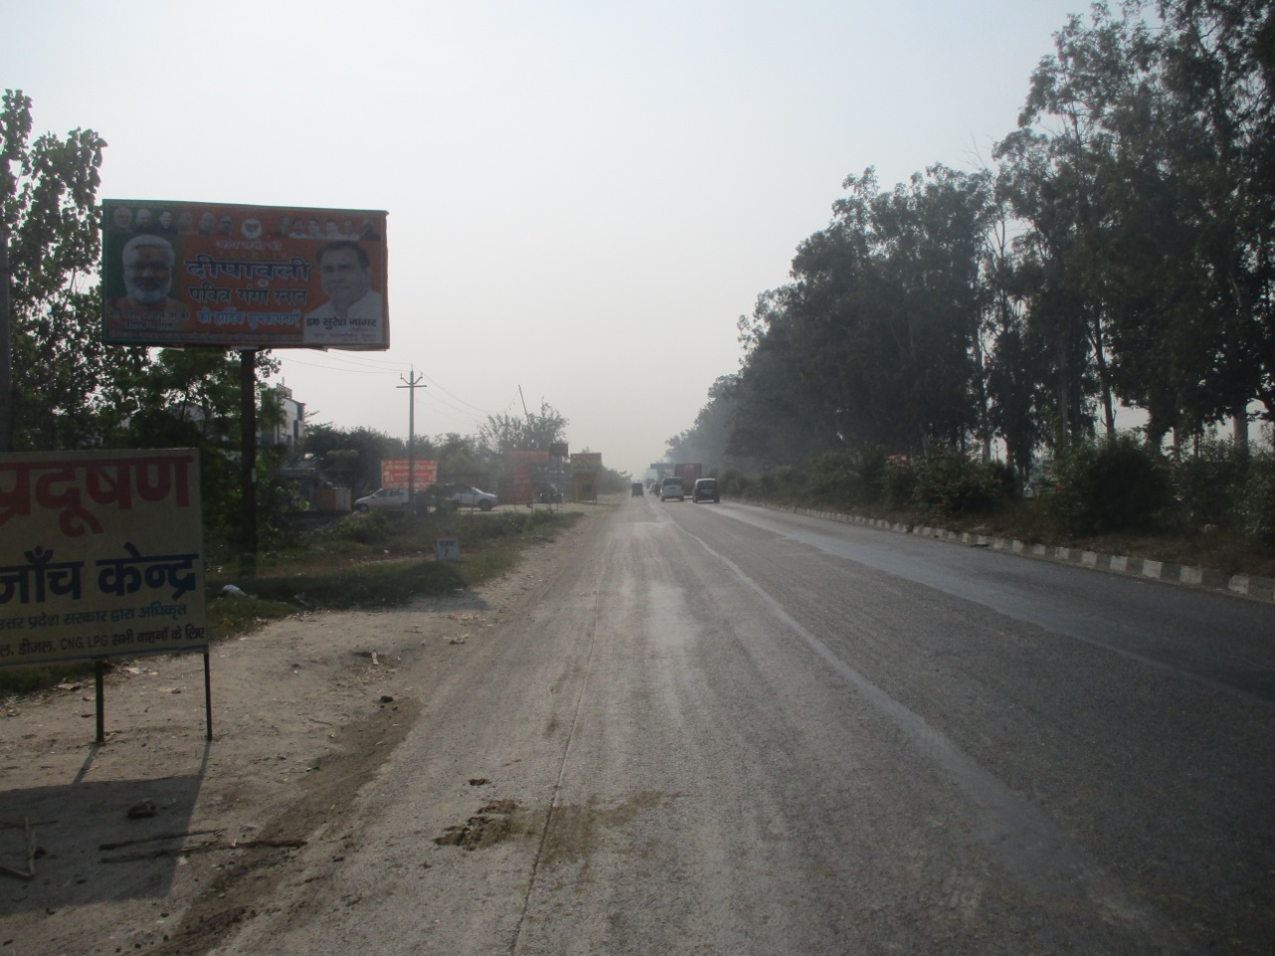

NH-24 VILL. KHALIPUR DHAL GAJROULA
MURADABAD TO HAPUR
Size : 20x10 Facing : Both side
Lit : Non Lit

Slide 32


NH-24 NAZEER HOTEL
HAPUR TO MURADABAD
Size : 30X15 Facing : Both side
Lit : Non Lit

Slide 33


NH-24 NEAR JUBLAND FACTORY GAJROULA
HAPUR TO MURADABAD
Size : 20X10 Facing : Both side
Lit : Non Lit

Slide 34


NH-24 NEAR JUBLAND FACTORY GAJROULA
HAPUR TO MURADABAD
Size : 30x10 Facing : Both side
Lit : Non Lit

Slide 35


NH-24 BHANPUR FATAK GAJROULA
HAPUR TO MURADABAD
Size : 30X15 Facing : Both side
Lit : Non Lit

Slide 36


NH-24 BHANPUR FATAK GAJROULA
HAPUR TO MURADABAD
Size : 20x10 Facing : Both side
Lit : Non Lit

Slide 37


NH-24 GAJROLA OPP. HAWLEY HOTEL
HAPUR TO MURADABAD
Size : 20x10 Facing : Both side
Lit : Non Lit

Slide 38


NH-24 NEAR MOGA HOTEL GAJROLA
HAPUR TO MURADABAD
Size : 25x10 Facing : Both side
Lit : Non Lit

Slide 39


NH-24 ATRASI NEAR UDIPIWALA HOTEL
MURADABAD TO HAPUR
Size : 20x10 Facing : Both side
Lit : Non Lit

Slide 40


NH-24 NEAR VENKATESHAWRA UNIVERSITY GAJROULA
MURADABAD TO HAPUR
Size : 20x10 Facing : Both side
Lit : Non Lit

Slide 41


NH-24 OPP. VENKATSHWRA UNIVERSITY GAJROULA
MURADABAD TO HAPUR
Size : 20x10 Facing : Both side
Lit : Non Lit

Slide 42


NH-24 NEAR MAHARAJA AGRASEN COLLGE GAJROULA
MURADABAD TO HAPUR
Size : 20x10 Facing : Both side
Lit : Non Lit

Slide 43


NH-24 Near Maruti Suzuki Showroom Gajrola
MURADABAD TO HAPUR
Size : 20x10 Facing : Both side
Lit : Non Lit

